Slide 1
Matt Garratt
Module 1: Level Crossing Concepts
07-APR-2025

Slide 2
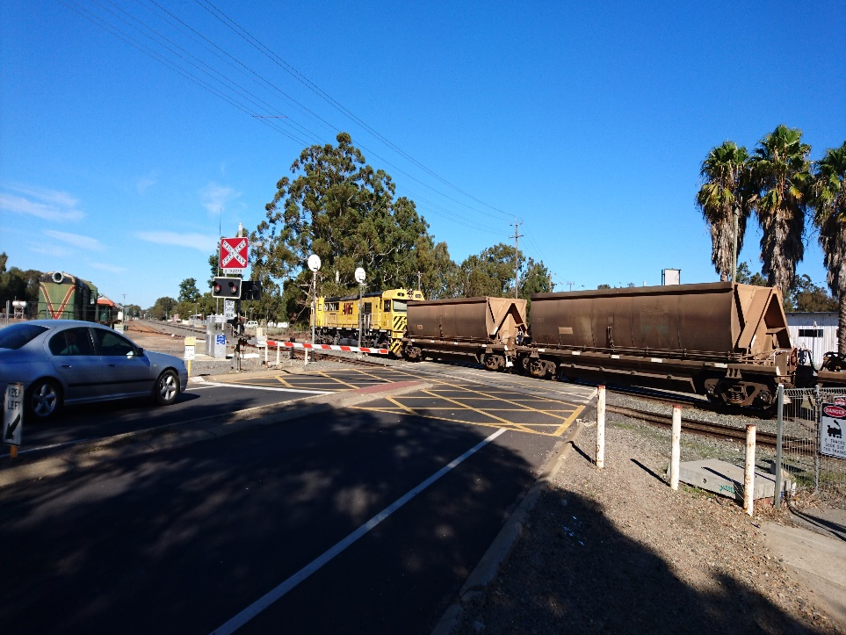
Level Crossing Safety
Why do we care about Level Crossing safety?
What happens if something goes wrong?
What are the risks?
Notes:
Discuss the questions above:
Share examples of something that went wrong at a Level Crossing - incidents that they have read about in the newspaper, experienced first hand or heard about. Consider the following:
What are some of the things that might go wrong?
An equipment failure and crossing lights flash continuously causing vehicle drivers to make their own decision to drive around the boom barriers or through the flashing lights.
A collision between a car/heavy vehicle and a train - the driver unable to see the train/car did not stop at the level crossing
Drivers queues back across the rail line – vehicle hit by a train
Pedestrians bypass active controls - either using the roadway, escape area or by jumping the pedestrian gates and is hit by a train
Pedestrian hit by a 2nd train
Potential consequences:
Fatalities and injuries
Infrastructure damage
Delays – road and rail
Reputation damage
Cost
ALCAM looks at risks to safety only.
ALCAM has a scope that is limited to the likelihood and immediate safety consequences of a collision at a level crossing.

Slide 3
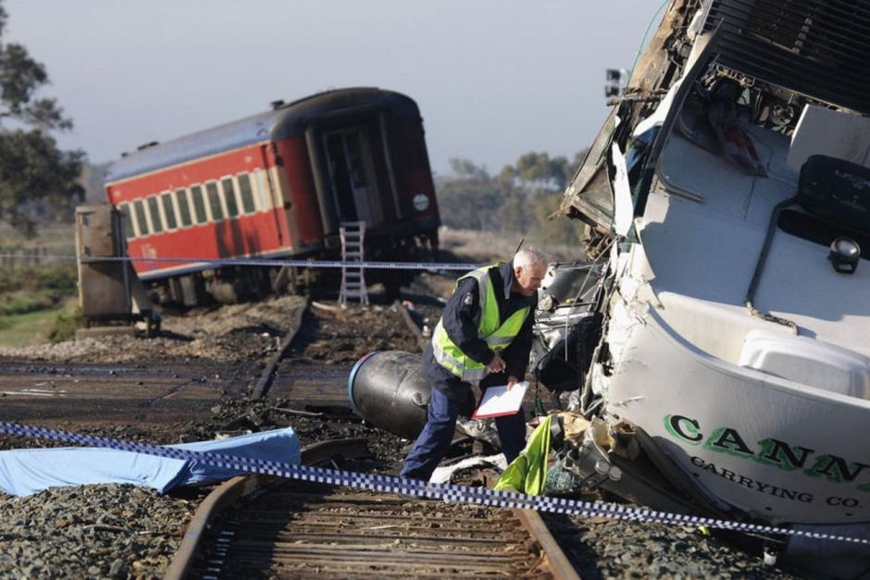
Consequence of LX incident
Notes:
Discuss as a group, the accident, the consequences, the possible cause:
The Kerang train accident occurred on 5 June 2007 approximately 6 kilometres north of the town of Kerang in Victoria.
Southbound V/Line passenger train was run into by a northbound semi-trailer truck, at a level crossing where the Yungera railway line crosses the Murray Valley Highway. The locomotive and first carriage escaped impact as the truck swerved left. However, the second carriage and third carriages were both struck, causing severe damage to the carriages and fatal injury to 11 of the passengers.
The truck had a mass of about 40 tonnes, and had been travelling at 100 km/h. The truck was extensively damaged on impact with the carriages. The driver sustained shoulder and head injuries.
Victoria Police confirmed that 11 people were killed and 23 injured in the crash, making this to date the deadliest Australian rail disaster since 1977.
The collision caused the closure of nearby sections of the Murray Valley Highway.

Slide 4
What is ALCAM?
Australian Level Crossing Assessment Model (ALCAM)
an assessment tool used to identify risks
can be used to assist in the prioritisation of crossings for upgrades
provides a process for decision making for level crossings safety improvements
Notes:
Australian Level Crossing Assessment Model (ALCAM) is an assessment tool used to identify risks at level crossings and produces a risk score. This can be used to assist in the prioritisation of crossings for upgrades. It provides a process for decision making for level crossings safety improvements;
ALCAM does not provide warrants for upgrades or attempt to define a ‘safe’ or acceptable level of risk.
This is a decision for each jurisdiction and will depend on the standard of existing crossings, upgrade budgets and the level of risk that they are prepared to tolerate.

Slide 5
Benefits of ALCAM
The provision of a common and consistent level crossing database in the form of the Level Crossing Management System (LXM)
Best practice risk assessment methods that include site conditions and characteristics, exposure, consequence and total risk expressed in common quantitative terms
The ability to objectively rank level crossings within a jurisdiction or region
Notes:
It was identified that a tool which consistently assessed the characteristics at each level crossing was required to effectively determine priorities when addressing safety hazards at these level crossings.
A project team was formed to establish such a tool. This was known as ALCAM and the model has undergone a variety of improvements to reach the stage it is at today.
The main benefits of ALCAM and the LXM system include:
The provision of a level crossing database
Best practice risk assessment methods that include site conditions, exposure, consequence and total risk
The identification of specific risk characteristics
The ability to objectively rank level crossings within a jurisdiction or region
Assessment of the overall effects of proposed treatments
The capacity to measure the reduction or elimination of road-rail interface risk
A means by which road and rail authorities can liaise with each other in respect of their individual and joint legislative and public risk reduction responsibilities
Model output in common quantitative terms (probability and expected fatalities), enabling cost-benefit analysis and integration into road funding models
The capacity for each railway crossing safety dollar to be spent where it can best generate the greatest safety improvement.

Slide 6
Course Objectives
Understand the purpose of performing an ALCAM survey and rating / risk score
Introduce and become familiar with an ALCAM survey process:
Prepare for a survey
Collect site data and characteristics
Complete a site sketch
Gain experience and capability using LXM:
Input ALCAM data
Upload photos and documents
Record observations
Review and interpret results
Notes:
It was identified that a tool which consistently assessed the characteristics at each level crossing was required to effectively determine priorities when addressing safety hazards at these level crossings.
A project team was formed to establish such a tool. This was known as ALCAM and the model has undergone a variety of improvements to reach the stage it is at today.
The main benefits of ALCAM and the LXM system include:
The provision of a level crossing database
Best practice risk assessment methods that include site conditions, exposure, consequence and total risk
The identification of specific risk characteristics
The ability to objectively rank level crossings within a jurisdiction or region
Assessment of the overall effects of proposed treatments
The capacity to measure the reduction or elimination of road-rail interface risk
A means by which road and rail authorities can liaise with each other in respect of their individual and joint legislative and public risk reduction responsibilities
Model output in common quantitative terms (probability and expected fatalities), enabling cost-benefit analysis and integration into road funding models
The capacity for each railway crossing safety dollar to be spent where it can best generate the greatest safety improvement.

Slide 7
Post-course services
Provide a quality assurance process for new surveyors
Point of contact for coaching and support
training@alcam.com.au
Post-course tasks
Request LXM access from the relevant org-admin
Complete ten ALCAM surveys (and have them verified) within 12 months
Coming soon: ALCAM for office-based team members (online)
Notes:
It was identified that a tool which consistently assessed the characteristics at each level crossing was required to effectively determine priorities when addressing safety hazards at these level crossings.
A project team was formed to establish such a tool. This was known as ALCAM and the model has undergone a variety of improvements to reach the stage it is at today.
The main benefits of ALCAM and the LXM system include:
The provision of a level crossing database
Best practice risk assessment methods that include site conditions, exposure, consequence and total risk
The identification of specific risk characteristics
The ability to objectively rank level crossings within a jurisdiction or region
Assessment of the overall effects of proposed treatments
The capacity to measure the reduction or elimination of road-rail interface risk
A means by which road and rail authorities can liaise with each other in respect of their individual and joint legislative and public risk reduction responsibilities
Model output in common quantitative terms (probability and expected fatalities), enabling cost-benefit analysis and integration into road funding models
The capacity for each railway crossing safety dollar to be spent where it can best generate the greatest safety improvement.

Slide 8
The ALCAM Process
The ALCAM road model comprises of three separate components: the Infrastructure Model, the Exposure Model and the Consequence Model. Each of these models has a single ‘factor’ as an output that, when combined, produces a risk score for each level crossing:
ALCAM Risk Score = Infrastructure Factor x Exposure Factor x Consequence Factor
Notes:
The ALCAM process involves the collection of data through a combination of level crossing surveys and train and vehicle information from the respective rail and road authorities.
Each level crossing is assessed uniformly using a standardised procedure to gather and interpret level crossing data.
The Infrastructure Factor is the output of a complex scoring algorithm that considers how physical properties at each site will affect human behaviours.
The Exposure Factor is a function of control type, vehicle (or pedestrian) volumes and train volumes.
The Consequence Factor is the expected outcome in the event of a collision and includes deaths and injuries on both the train and vehicle.
The ALCAM Risk Score is expressed in terms of an expected number of equivalent fatalities per year.
An equivalent fatality is a combination of all types of harm using the ratio:
1 fatality = 10 serious injuries = 200 minor injuries

Slide 9
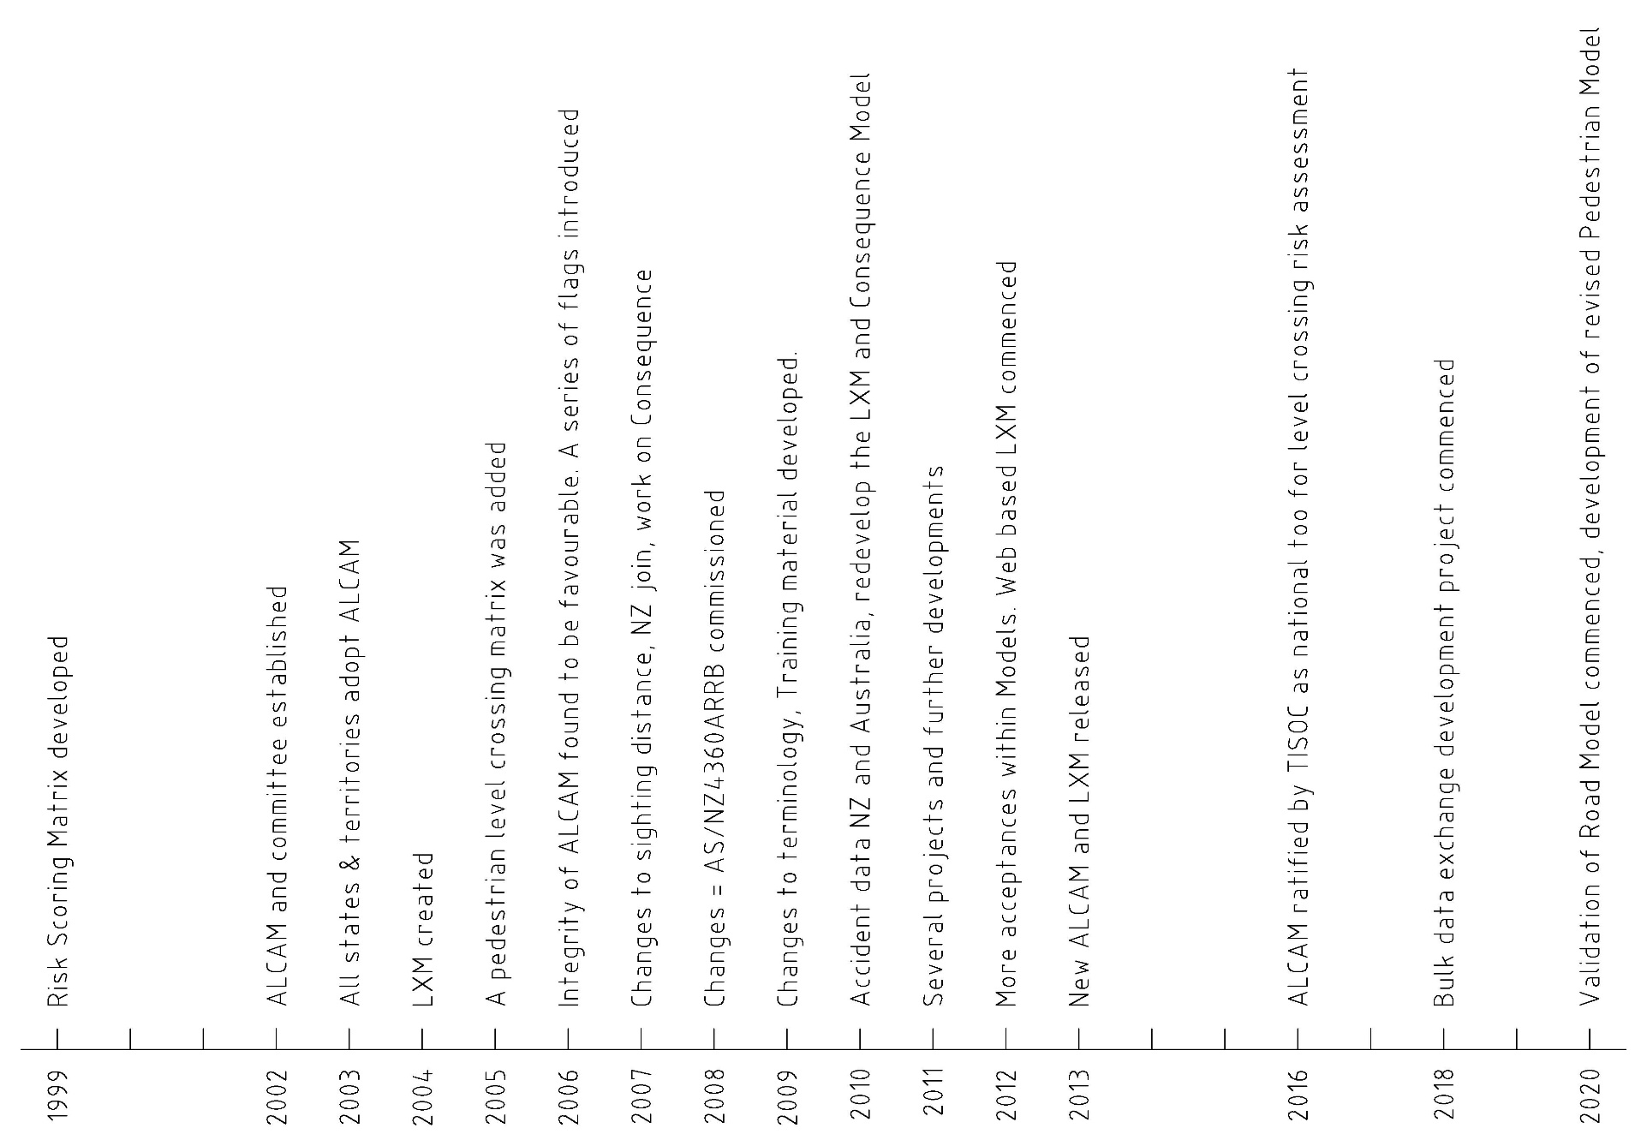
History of ALCAM
Notes:
Formally storing crossing and assessing crossing risk began in 1999. A project team was tasked with developing a tool and technical guidelines for the assessment and treatment of level crossings and oversee the development of a database for level crossings. A simple database to hold crossing data and a spreadsheet called the Risk Score Matrix to assess the risk at level crossings were developed.
In 2003 Australian Transport Council and SCOT (Rail Group) sanctioned that the ALCAM be adopted nationally. In 2004 this initial system was developed into a Microsoft Access database named the Level Crossing Management System (LXM) combining the data management and the risk scoring (ALCAM) in one system.
Since then the system has undergone continual development and improvement to the multi-jurisdiction web based system in use today.

Slide 10
The National ALCAM Committee
The National ALCAM Committee which was established in 2002 has memberships from all states & territories across Australia and NZ which have operating railways.
The role of the ALCAM committee is to provide ongoing support to ALCAM users to ensure a consistent approach to assessments and the use of the LXM system, progress technical issues and continue to develop ALCAM and LXM system.

Slide 11
National ALCAM Committee members
Department of Infrastructure, Planning and Logistics
Queensland
Rail
Main Roads Western Australia
Transport
for NSW
Department of Transport Victoria
Department of Planning, Transport & Infrastructure
TasRail
KiwiRail
https://www.google.com/search?site=&tbm=isch&source=hp&biw=1680&bih=955&q=map+australia+and+new+zealand&oq=map+australia+and+new+zealand&gs_l=img.3...1423.9536.0.9685.29.23.0.2.2.0.363.2547.2-8j2.10.0....0...1ac.1.64.img..17.12.2559.GGSLwT32EjY#imgrc=MJI7_btLGAipLM%3A
Notes:
The ALCAM Committee has memberships from all states & territories across Australia and NZ which have operating railways. The member organisations are included above.
The ALCAM committee established the ALCAM Model, the LXM database, and gives ongoing advice about ALCAM to ensure consistency and continuous improvement and progress technical issues.

Slide 12
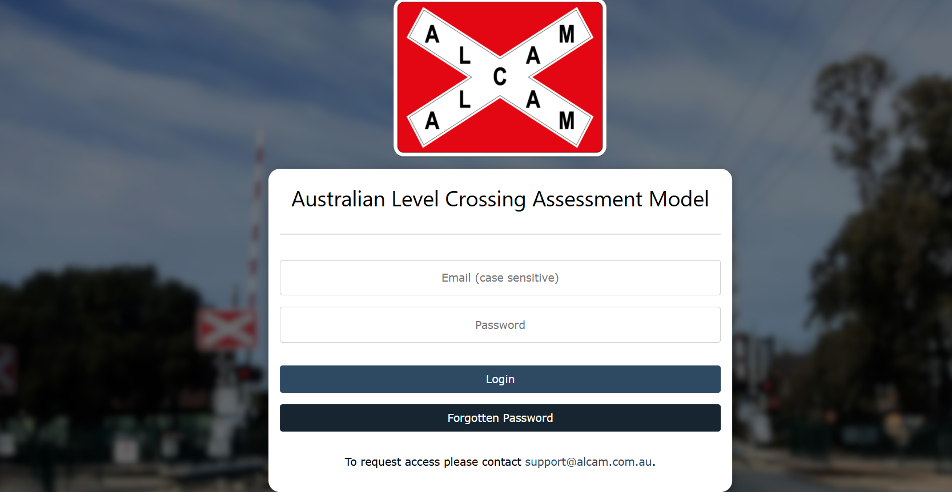
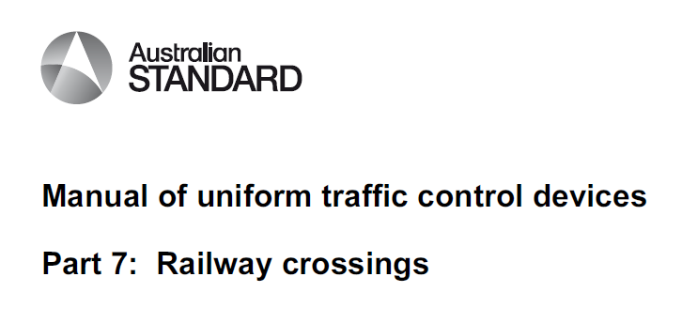
ALCAM resources and references
Notes:
There are many resources available – some of the key resources are listed below:
LXM User Guide
ALCAM Crossing Assessment Handbook
ALCAM in detail
AS1742.7 (Australia)
NZTA TCD Part 9 (New Zealand)

Slide 13
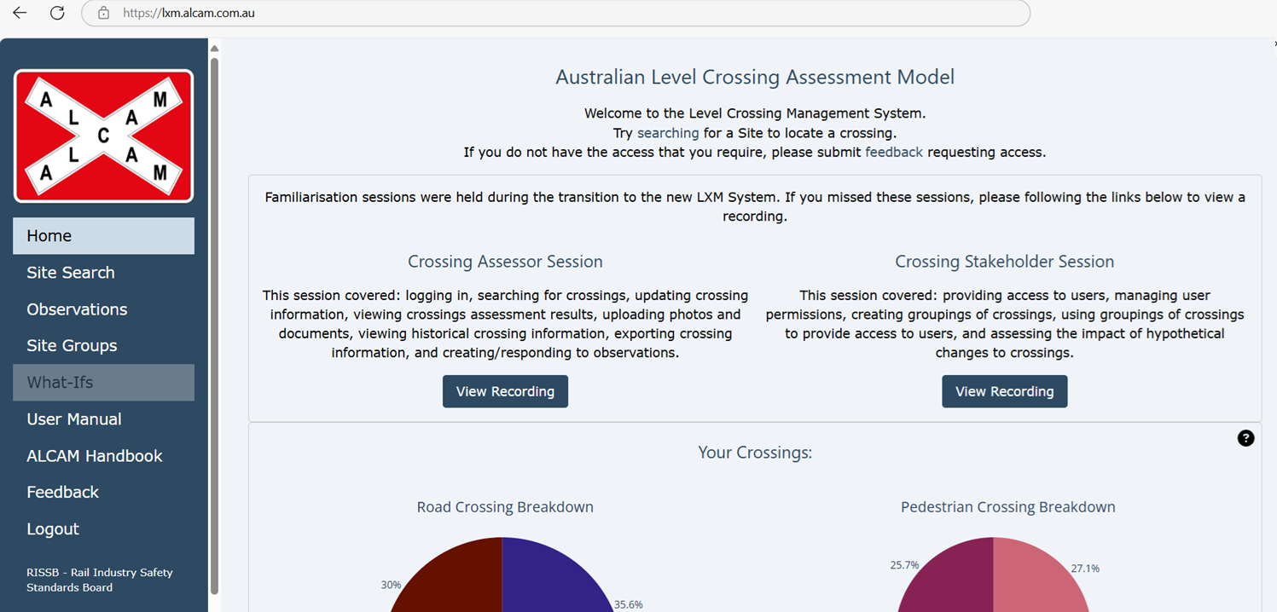
LXM
The Level Crossing Management System (LXM) is an integrated data management system used to provide for the effective management of ALCAM data as well as other important information.
Notes:
LXM contains a number of additional reporting and modelling tools to assist with the overall decision-making process.

Slide 14
What is a level crossing?
AS1742.7 defines a level crossing as:
Any crossing of a railway at grade, providing for vehicular traffic and/or other road users including pedestrians.
Notes:
A railway level crossings is a place where a railway and a road/footpath cross at the same level where trains have right of way.
It is a traffic system interface, not just a traffic signal between a road and the rail. Level crossings are a critical interface between road and rail that needs the attention of railway owners and road authorities to adequately address all the safety risks, the objective being that trains, cars and pedestrians can travel safely. Hence we install infrastructure that warns, guides, and controls crossing users by way of signs, road markings, flashing lights, booms, and good quality road surfaces for both vehicles and pedestrians.

Slide 15
Types of level crossings
A level crossing site may be:
a road crossing,
a road crossing with one or more adjacent pedestrian crossings, or
single or multiple pedestrian mid-block (or standalone) crossings with no adjacent road crossing e.g. at station platforms.
Notes:
Level crossings are grouped into ‘crossing sites’ and may be:
a road crossing (the most common situation)
a pedestrian crossing
a road crossing with one or more adjacent pedestrian crossings
Multiple pedestrian crossings with no adjacent road crossing e.g. at station platforms.
There can not be multiple road crossings at a single crossing site.

Slide 16
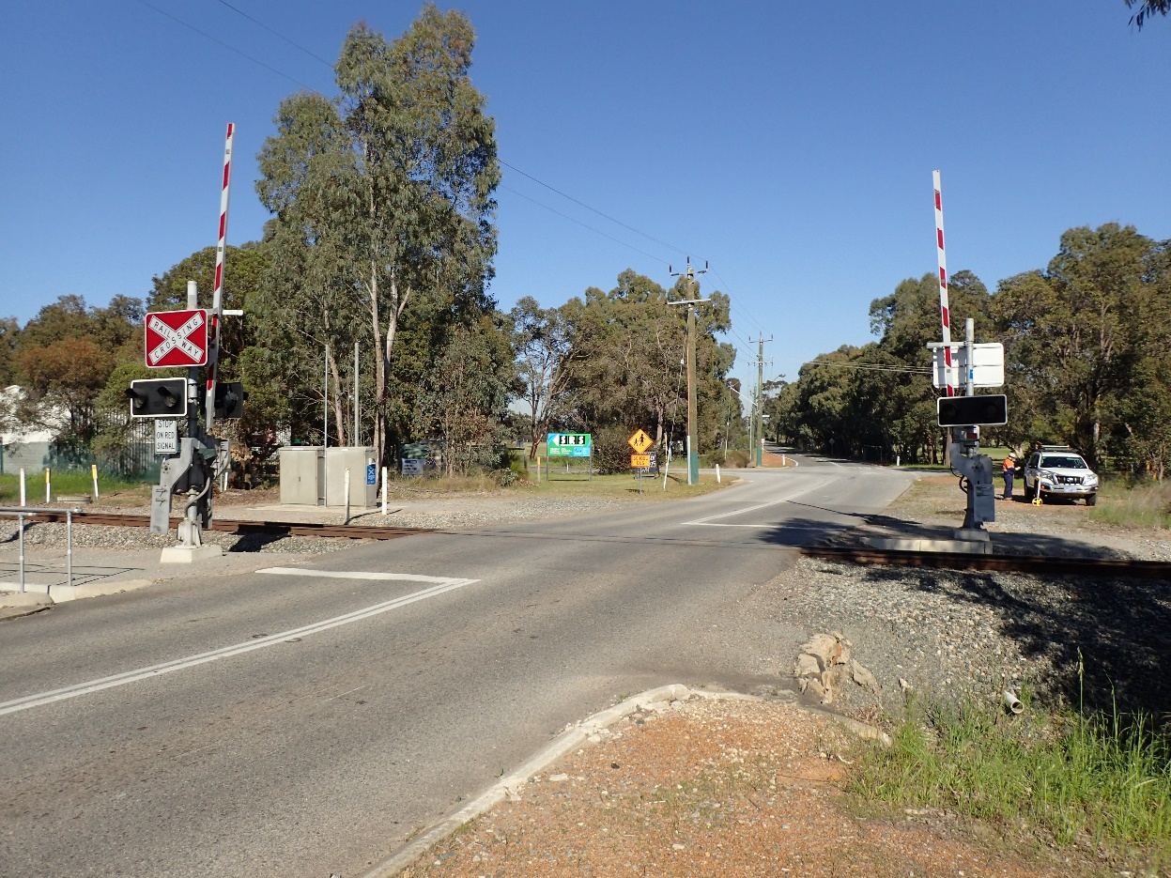
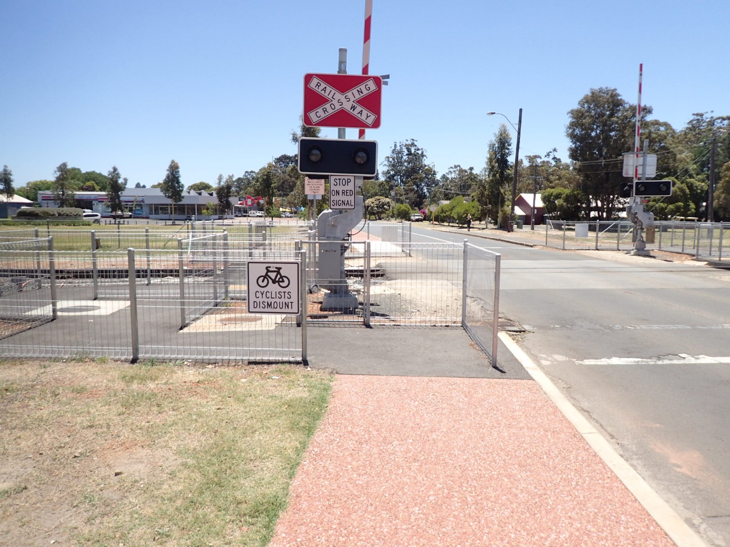
Road only crossing
Road crossing with adjacent pedestrian crossings
Notes:
An example of a road only crossing and a road crossing with adjacent pedestrian crossings.

Slide 17
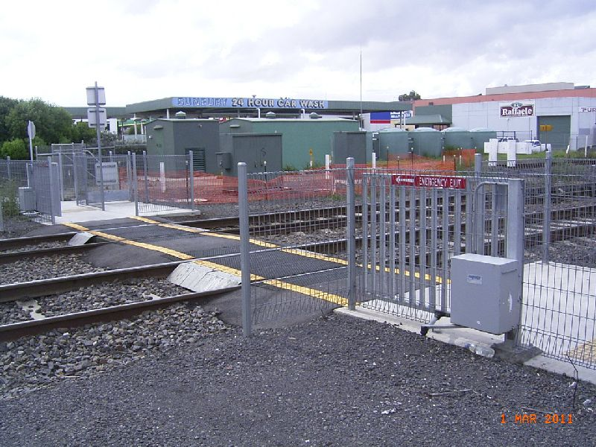
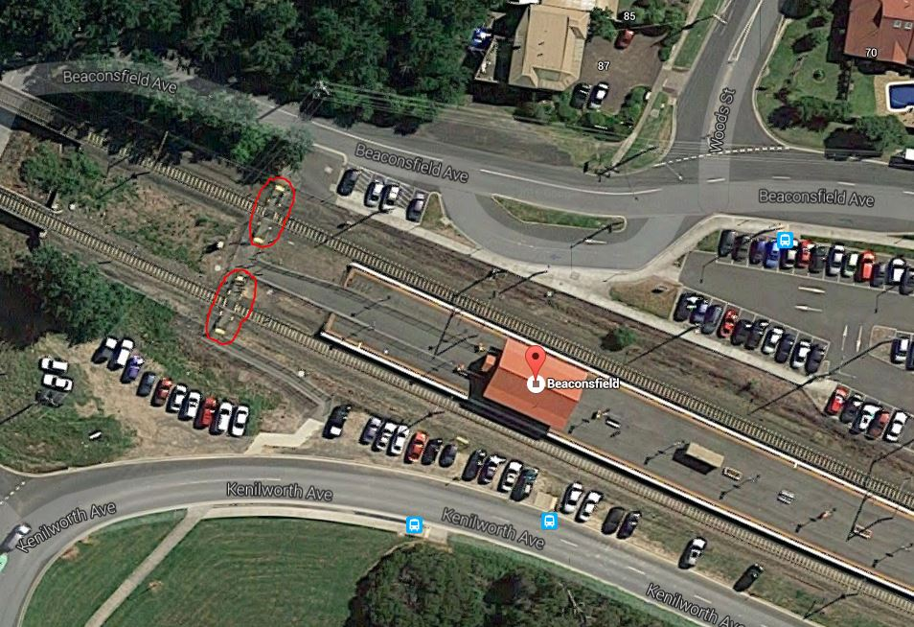
Single pedestrian mid-block crossing
Multiple pedestrian mid-block crossings
Notes:
An example of a pedestrian only crossing. Some jurisdictions refer to them as a standalone pedestrian crossings, but can also be called a mid-block pedestrian crossing.
An example of multiple pedestrian crossings at a location (circled in red).

Slide 18
The Workings of Level Crossings: Road
Types of road controls
Passive
RX-1 Give Way
RX-2 Stop
Active
RX-5 Flashing Lights
RX-5 Boom Gates (half, full or 4-quadrant)
Notes:
The types of control found at a road crossing may be:
Passive i.e. signs where the crossing user must observe the train and make their own judgement on whether it is safe to cross
Active i.e. the control is activated by the approach of a train.
Boom gates may be:
half where the boom extends over the crossing approach lane/s only
Full where the boom extends over the whole road width
4 – quadrant usually on two lane roads in QLD where a separate boom extends over each lane of traffic, the booms on the approach lanes descending first with a delay for the descent of the departure lane booms to allow vehicles already on the crossing to exit before the boom descends.

Slide 19
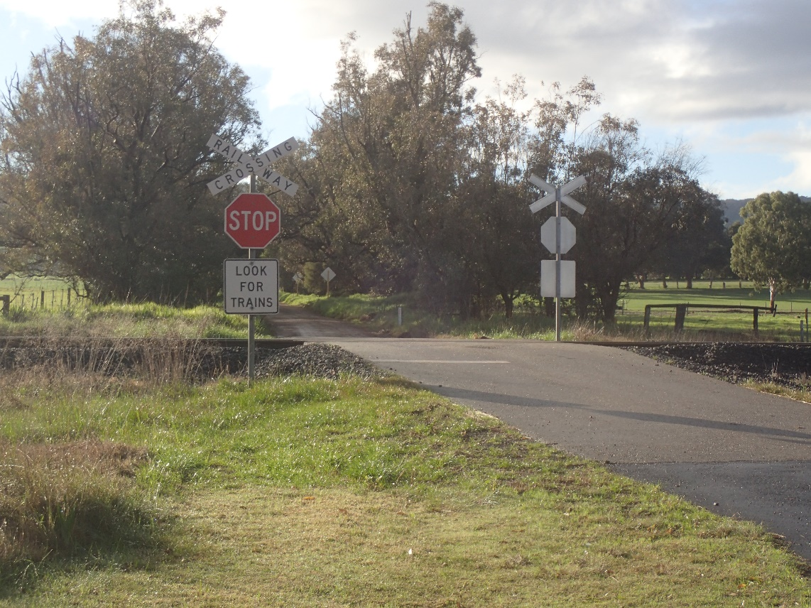
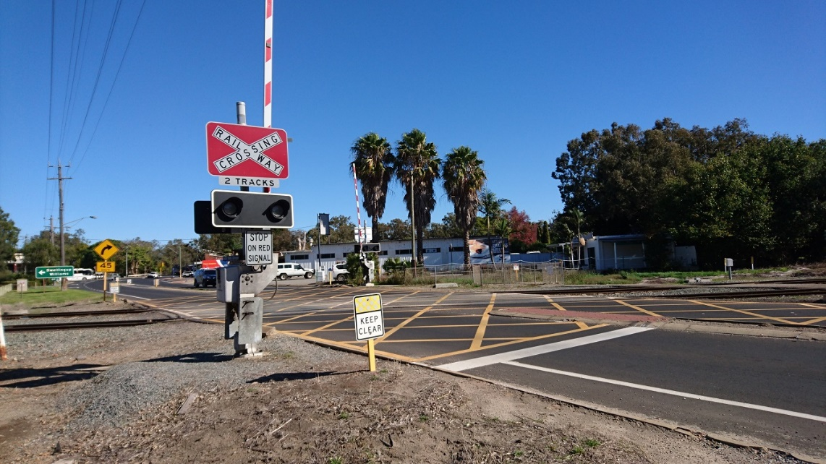
The Workings of Level Crossings: Road Control Examples
Passive Crossing
Active Crossing
Notes:
This is an example of a passive crossing which uses a Stop Signs and an active crossing with Boom Gates

Slide 20
The Workings of Level Crossings: Pedestrian
Types of pedestrian controls
Passive
Path with signs
Maze with signs
Active
Maze with active RX-12 assembly
Maze with active gate and RX-12 assembly
Notes:
Similarly, pedestrian crossing control can be:
Passive - signs at a path or maze
Active – a gated maze where gates activated by the approach of a train close off access over the track. Or a passive maze with red man / green man and or audible alarm warning activated on the approach of a train.

Slide 21
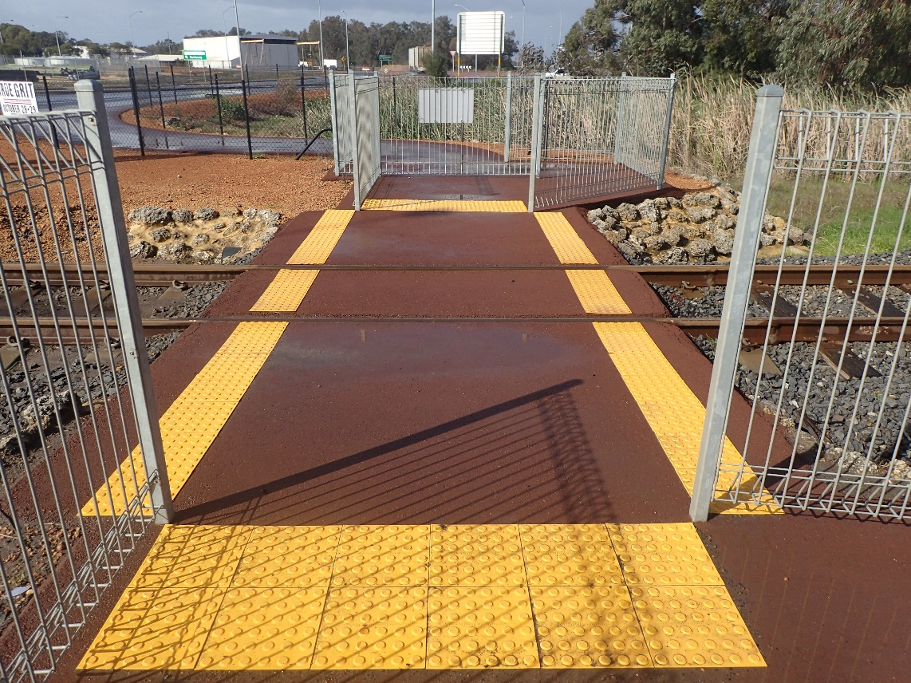
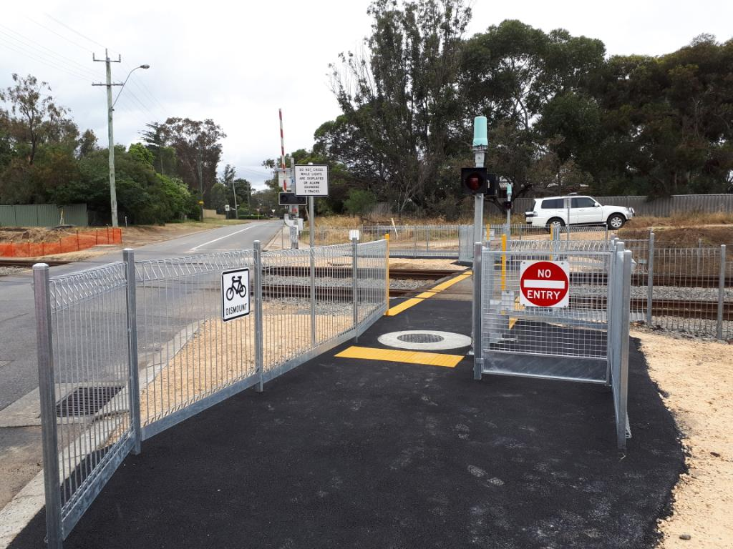
The Workings of Level Crossings: Pedestrian Control Examples
Maze with active gate & RX-12 assembly
Passive maze with signs
Notes:
The above are examples of a passively controlled pedestrian crossing with mazes and an active controlled pedestrian crossing with automatic gates, flashing lights and audible warning devices (RX-12 assemblies)

Slide 22
Australian Standard AS1742.7
AS1742.7:2016 - Manual of uniform traffic control devices Part 7: Railway Crossings is the standard which shall apply to all Public Road level crossings with Australia.
This Standard sets out:
The control devices to be used at level crossings
The signage to be used in advance of level crossings
The way in which these devices and signage are to be used
The sighting distance requirements at level crossings.
Notes:
AS1742.7 describes the uniform standards and practices in the use of signs, pavement markings and other devices to be applied at public level crossings. It specifies the way in which these devices are used to achieve the level of traffic control required for the safety of rail traffic, road users, cyclists, and pedestrians. Requirements and guidance are also given on sighting distance requirements, location and installation of signs, illumination of signs and other topics.
Whilst AS1742.7 identifies what control devices and signage are to be used at level crossings, AS1742.2 outlines the standards for the size and construction of these devices and signage.

Slide 23
AS1742.7: Interpretation of wording used
Shall
Indicates that a statement is mandatory.
For example: “The RX-5 assembly shall be used at crossings that require flashing signal control.”
Should
Indicates a recommendation.
For example “Overhead flashing signals should be used in conjunction with pedestal mounted assemblies in the following cases . . . .”
May
Indicates the existence of an option.
For example “Extended range signal lanterns may be used as recommended in AS/NZS 2144.”
Notes:
It should also be noted that appendices in AS1742.7 are classed as either “normative” or “informative”. A “normative” appendix is an integral part of the standard whilst an “informative” appendix is only for information and guidance. This is similar to the distinction between “shall” and “should” above

Slide 24
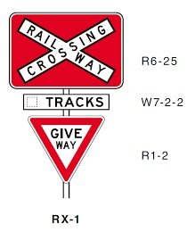
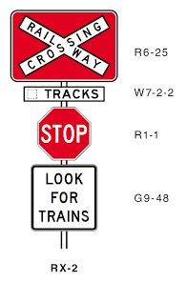
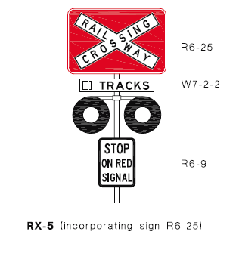
AS1742.2: Control Signage - Roads
Notes:
Examples of Level Crossing Controls which are likely to be observed whilst undertaking ALCAM field surveys.

Slide 25
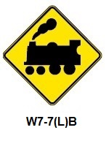
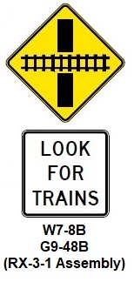
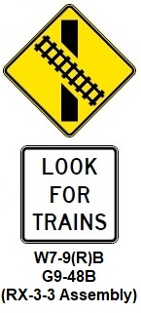
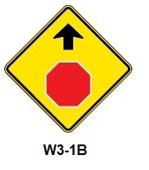
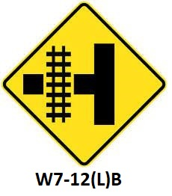
AS1742.2: Advance Warning Signage at Passive Controls- Roads
Notes:
Examples of Level Crossing Advance Warning Signage which are likely to be observed whilst undertaking ALCAM field surveys.

Slide 26
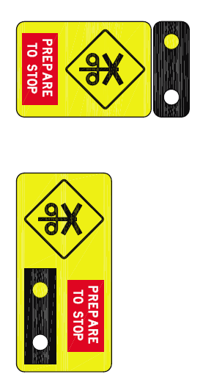
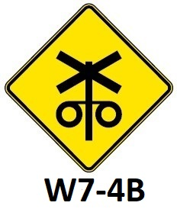
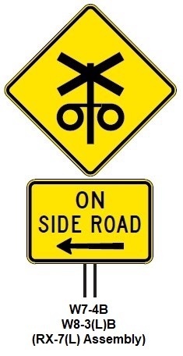
AS1742.2: Advance Warning Signage at Active Controls- Roads
Notes:
Additional examples of Level Crossing Advance Warning Signage which are likely to be observed whilst undertaking ALCAM field surveys.

Slide 27
Level Crossing Stakeholders:
Road Managers
Road & Rail Users
Transport Authorities
Rail Infrastructure Managers
Government Authorities
Emergency Services
Rail Transport Operators
Notes:
Level crossings have a broad range of level crossing stakeholders (including pedestrians, train users, vehicle passengers, train drivers, local residents etc.)

Slide 28
Level Crossing Stakeholders: Stakeholders for ALCAM
Level crossing Stakeholders are also considered stakeholders for ALCAM because of their responsibilities under legislation to manage risk in relation to level crossings. These are:
Road Managers
Path Managers
Rail Infrastructure Managers
Rail Transport Operators
Notes:
The stakeholders in relation to ALCAM have a narrower focus:
Road Manager
If the crossing includes a road (i.e. is not a pedestrian only crossing) there will be an organisation or individual who has the primary maintenance responsibility for the roadway and associated approach signage. In the case of a public road, this will be either the main road authority for the State, or the local council within which the crossing falls.
Path Manager
If the crossing includes a pedestrian crossing there will be an organisation or individual who has the maintenance responsibility for the approach paths and advance approach signage. This will generally be a local council within which the crossing falls.
Rail Infrastructure Manager
Rail Infrastructure Manager is the organisation which has the legal responsibility for the management of the railway track and signalling infrastructure, either through ownership of that asset, or where the owner has leased the infrastructure to the organisation/s, which then have legal obligations to manage that infrastructure.
Rail Transport Operator
A Rail Transport Operator is an organisation which operates trains on a rail line. Operators are not considered stakeholders from an ALCAM perspective although they are included in the data for information purposes.
A clear understanding of the ownership and legal responsibility for infrastructure maintenance of the rail networks and operation or rail services over those networks on which assessed railway crossings are located is therefore required.

Slide 29
Key level crossing stakeholders
At the level crossing pictured, there are four different stakeholders:
Road Manager – responsible for managing the road
Path Manager – responsible for managing the adjacent footpath
Rail Infrastructure Manager – responsible for managing the rail infrastructure
Rail Transport Operator – responsible for operation of rolling stock.
Notes:
With respect to a data collector, a good relationship with each of these stakeholders should be established, both in terms of the requirement for on-site safety at the crossing and some of the data required to complete crossing assessments may need to be obtained from these organisations

Slide 30
Level Crossing Site Definition
Key components to identify a level crossing site
Rail line name, rail kilometrage and Line Code
A unique identification number
Road name, number and Straight Line Kilometrage (SLK)
Co-ordinates
Notes:
Each crossing site has key components that identify it and it’s location. These are:
The rail line name, rail kilometrage and Line Code where it is located
A unique identifying number – this is a unique number assigned to a crossing. It is generated by the ALCAM and used to reference the crossing.
A crossing name – the formal name of road as identified by sources such as street directories or street signs, regional maps, or emergency services maps. A crossing may also have a local commonly known or colloquial name. A stand-alone pedestrian crossing may be named by the nearest street or road or access point e.g. Ferny Grove Station Pedestrian Access.
Geographic co-ordinates

Slide 31
Level Crossing Site Definition: Orientation of the Site
Notes:
ALCAM surveys and the LXM software use a consistent convention to refer to the orientation of level crossing sites.
Up direction is towards the origin of the track. i.e. when standing at the crossing and facing in a direction of decreasing track kilometrage, you are facing in an Up direction.
Down direction is away from the origin of the track. i.e. when standing at the crossing and facing in a direction of increasing track kilometrage, you are facing in a Down direction.
Note: The interpretation of Up direction may vary between jurisdictions and should be confirmed.
Locations of level crossings are referred to by their running kilometrage, or the distance (in kilometres) from the origin of the line.
The direction of the road or path approaches is defined as left or right, based on the observer’s left- or right-hand side when at the crossing facing in the Up direction.

Slide 32
Level Crossing Site Definition: Crossing Quadrants
Quadrant 1 (Q1)
Right Up (RU)
Quadrant 2 (Q2)
Right Down (RD)
Quadrant 3 (Q3)
Left Up (LU)
Quadrant 4 (Q4)
Left Down (LD)
Notes:
The intersection of the road and rail divides the site into four quadrants:
Therefore the right UP side is quadrant 1
The right DOWN side is quadrant 2
The left UP side is quadrant 3
And the left DOWN side is quadrant 4

Slide 33
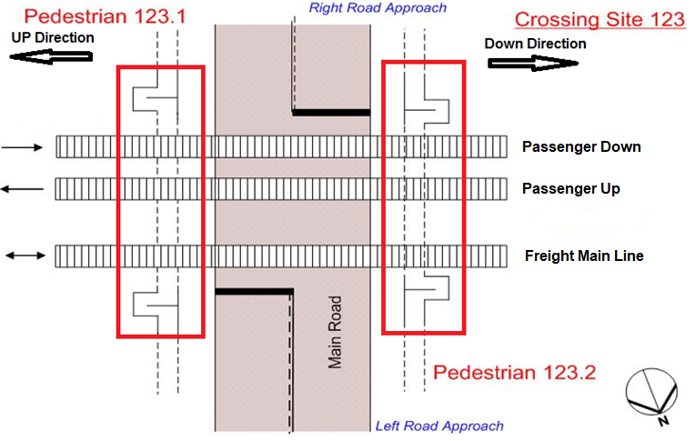
Level Crossing Site Definition: Crossing Entities
Notes:
Where multiple adjacent pedestrian crossings exist, the individual pedestrian crossings are numbered as per the above.
The pedestrian facility on the Up side of the road crossing is Ped Crossing No.1, the pedestrian facility on the Down side of the road crossing is Ped Crossing No.2

Slide 34
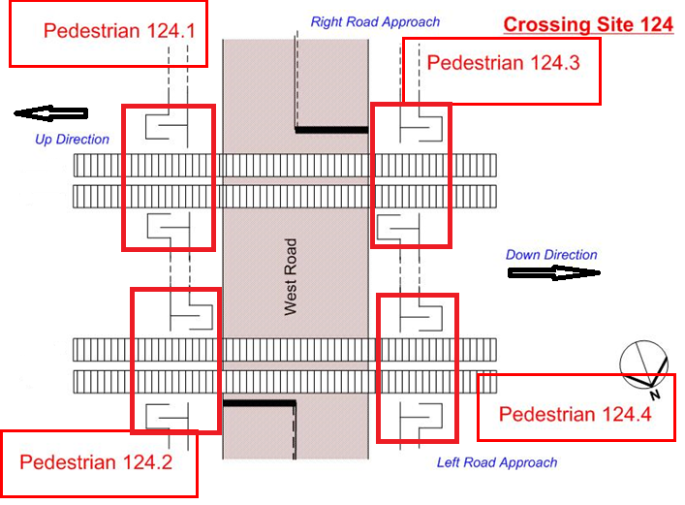
Level Crossing Site Definition: Crossing Entities
Notes:
Where multiple adjacent pedestrian crossings exist on both sides of the road crossing, the individual pedestrian crossings are numbered as per the above.
Therefore the right UP side is Ped Crossing No.1
The left UP side is Ped Crossing No.2
The right DOWN side is Ped Crossing No.3
And the left DOWN side is Ped Crossing No.4

Slide 35
Level Crossing Classification
There are two types of level crossing:
Public – a road or path for use by the public
Private – a road or path which provides access to a private property
Notes:
We all know the two main types of level crossing:
Public – for use by the general public, both vehicular or pedestrian
Private - to provide access to private land either to access the property from a road for use by the property owner and their invitees or from one part of the property to another.
Private crossings include railway maintenance or service crossings solely for railway staff and used for track maintenance purposes, for
access in station yards or for access to railway infrastructure.

Slide 36
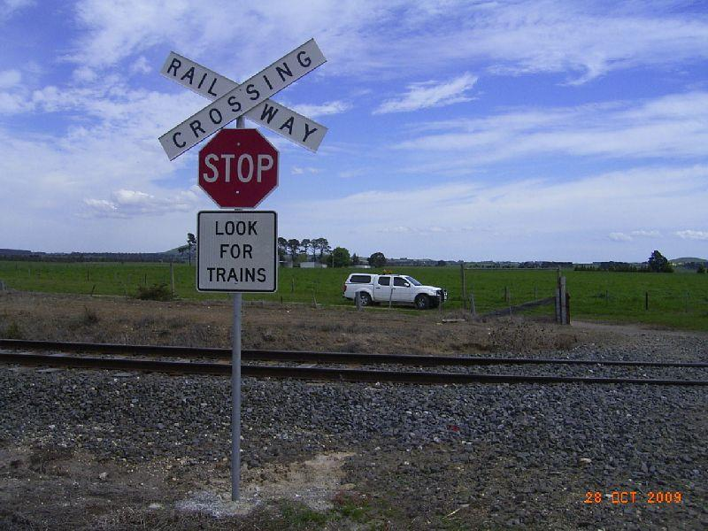
Level Crossing Classification: Legal Status
Public
Private
Service
Illegal
Notes:
In the ALCAM system level crossings have been categorised according to their legal status.
Public (statutory): Declared public roads and associated pedestrian crossings, official mid-block pedestrian crossings provided by Local Government or Railway for pedestrian access across tracks. Includes end-of-platform pedestrian crossings for access to passenger platforms.
Private: Access to private land by the landowner, service providers to that landowner, or employees of that land-owner (e.g. Occupation crossings, factory or large farm access where the public is not permitted or invited but employees, contractors, and suppliers may enter). This would include access by delivery vehicles, as long as the access is restricted and the Public are not welcome. However some private crossings may have public access in circumstances such as a golf club, or plant nursery.
Service: Crossings used by railway only and not available for public use
Illegal: Road or pedestrian path across the tracks has been constructed without the consent of the rail authority or local council.

Slide 37
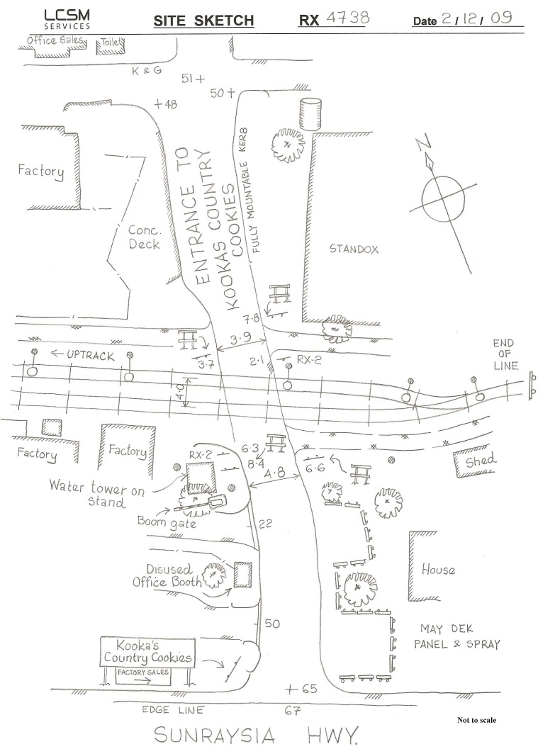
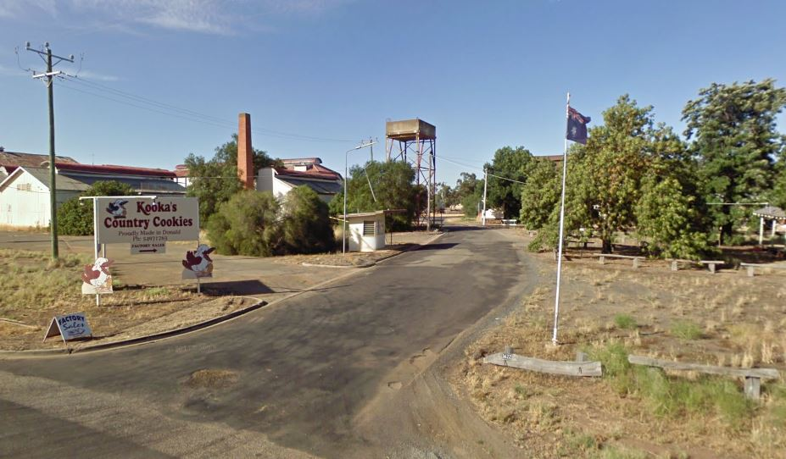
Level Crossing Classification: Access
Public
Private
Notes:
Access describes the type of access, regardless of Legal Status:
Public – Open to public access
Private – Access restricted to occupier or by other people with the knowledge and agreement of the occupier
Legal Status and Access are independent of each other and so, for example, a Private crossing may have public accessibility in some circumstances. E.g. a level crossing may be used to access a winery/private commercial building where the access road is a private road
The example in the picture is of private crossing but the public uses it to access a business.

Slide 38
Level Crossing Classification: Crossing Class
Crossing Class= Legal Status + Access
CROSSING CLASS INDEX
Crossing Class | Legal Status | Access Type | Legal Status Group
Public road / path - Public access | Public | Public | Public
Public road / path - Private access | Public | Private | Public
Private road / path - Public access | Private | Public | Private
Private road / path - Private access | Private | Private | Private
Service road / path - Railway use only | Private | Private | Private
Illegal road / path - Public access | Illegal | Public | Private
Illegal road / path - Private access | Illegal | Private | Private
Unknown road / path - Public access | Unknown | Public | Private
Unknown road / path - Private access | Unknown | Private | Private
Notes:
Putting the ALCAM Legal Status and Access together forms the Crossing Classes as shown above.

Slide 39
Questions…

Slide 40
Matt Garratt
Level Crossing Field Assessment –
Measurement Methods & Process
07-APR-2025

Slide 41
Office Based Data Collection
There are a number of pieces of information which are required to be collected prior to travelling to site to undertaken an ALCAM assessment.
This information includes the level crossing location details, rail traffic information and road traffic information.

Slide 42
Crossing Location Details
The following crossing location details are to be collected prior to travelling to site to undertake an ALCAM assessment;
LXM/ALCAM Crossing ID
Crossing Class
Road Name, Number & SLK
Line Section & kilometrage
Suburb
Surrounds
Rail Infrastructure Manager
Road Manager
Restricted Emergency Access

Slide 43
Rail Traffic Information
The following rail traffic information details should be obtained from the relevant Rail Infrastructure Managers prior to travelling to site to undertake an ALCAM assessment;
Physical tracks
Operational tracks
Train Speeds
Maximum
Minimum
Permanent Speed Restrictions
Train Volumes (Yearly, Weekly or Daily)
Longest Train Length
Average Wagons
Average Occupancy
Active Warning Timings
Longest
Shortest

Slide 44
Road Traffic Information
The following road traffic information details should be obtained from the relevant Road Managers prior to travelling to site to undertake an ALCAM assessment;
Restricted Access Vehicle (RAV) network
Legal Speed Limit
AADT (if available)
All Traffic
Heavy Vehicle Percentage
Buses
Date of AADT Survey

Slide 45
Site Assessment Methodology
Notes:
NOTE: The following slides outline the tasks required in undertaking the field based assessment activities associated with an ALCAM assessment.
The order in which these tasks are completed may be varied provided that all of the information identified is collected.

Slide 46
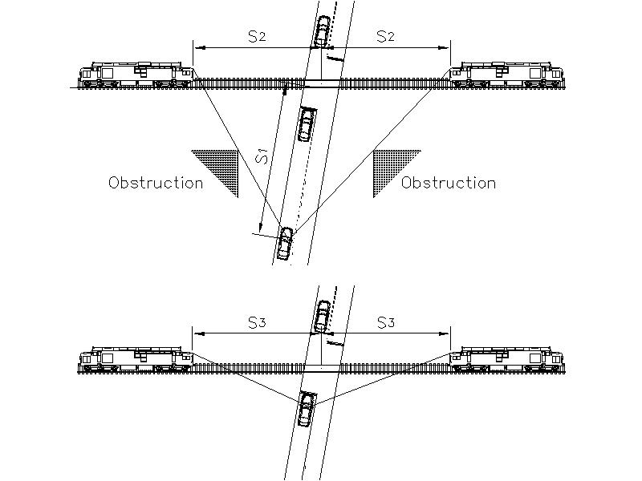
Sighting Distances – SSD/S1, S2 & S3
Sighting distance is measured for 3 key aspects of the road approach to railway crossings:
S₁ (SSD) - distance from the crossing on each approach that the driver of a vehicle can first sight the crossing control and safely stop;
S₂ - distance from the crossing on each quadrant that an approaching train can be first sighted by the driver of a vehicle located at S₁; and
S₃ - distance from the crossing on each quadrant that an approaching train can be first sighted by the driver of a vehicle stopped at the crossing.

Slide 47
Sighting Distances – SSD/S1, S2 & S3
The main purpose of measuring the sight distance is to determine if crossing users have adequate sight distance to the crossing, crossing controls, and an approaching train in order to cross safely, or stop and wait for an approaching train to pass.
Sighting distances are measured to within the nearest metre generally utilising range finding binoculars.
The sight distance requirements for road users are;
SSD (Stopping Sight Distance)/S1
Maximum Available SSD
S2
S3

Slide 48
Direction (Bearings/Angles) – Along the Road & Along the Track
The bearing/angle of road approaches, track alignments and sighting triangles are all measured as part of an ALCAM field assessment.
Measurement precision for bearings/angles as a minimum should be to the nearest 2 degrees using a hand bearing compass or where available, range finding binoculars with an in-built compass.
The bearing/angle measurement requirements are;
Up Direction magnetic bearing
Road exit magnetic bearings/angles – Left & Right approaches
S2 bearings Up & Down track – Left & Right approaches
S1/SSD bearing back to the crossing – Left & Right approaches

Slide 49
85th Percentile Speed
The 85th percentile speed is the speed at which 85% of all types of vehicles on the road are observed to travel past a nominated point under free-flowing conditions.
The nominated point is where the crossing is clearly visible, and the driver reacts to the visual cue and adjusts speed to approach the crossing. This point is generally in the vicinity of the advance warning signage.

Slide 50
Determining the 85th percentile speed
The 85th percentile speed should be determined prior to commencing an ALCAM site assessment and is generally determined whilst travelling to the crossing site.
The 85th percentile speed can be determined by driving through the crossing from each direction and recording the speed at which you are travelling when you can clearly identify and react to the crossing controls.
Drive in a manner of a confident driver who is unfamiliar with the road.
If the road is used predominantly by heavy vehicles, the speed may differ from that estimated by the surveyor in a smaller vehicle and this should be taken into consideration.
If the road is curved with a sharp bend close to the crossing which forces drivers to slow down as they cross the tracks, ensure the approach speed is measured as described above; do not record the slower speed as you cross the tracks.
Whilst driving through the crossing from each approach, if a signposted road speed is observed, this needs to be photographed and recorded against the relevant approach on your data collection sheet.
An alternate method in determining the 85th percentile speed can be to set the 85th percentile speed as the road speed limit plus 10% as per AS17427
Notes:
In cases where there are sharp bends forcing drivers to slow down as they approach the level crossing, the approach speed should be measured where the driver will first recognise and react to the crossing controls. Do not record the slower speed when crossing over the rail tracks.
For vehicles approaching from a side road or T-intersection, the 85th percentile is the higher speed of:
• the speed of the vehicle when it completes the turn from the side road towards the crossing and the driver first recognises the crossing controls, or
• the accelerated speed from this intersection point travelling towards the crossing when the driver first recognises the crossing controls.
Alternate methods for determining the 85th percentile speed include;
• Utilising a road traffic count at a location near where drivers react to the crossing signage:
o The measured 85th percentile speeds extracted from the count data.
o This method is best suited for crossings on long straight stretches of road.
• If traffic flow is sufficient measure the speed of a sample of vehicles using a hand-held speed measuring device where the drivers react to the crossing controls.
• Engage a specialist to undertake a road traffic count. The location of where the count is taken should be at the point where the drivers react to the crossing controls.

Slide 51
Example S1 Table
Level 1 Semi-Trailer 20m lg & Level 2a B-Double 26m lg |  |  |  |  |  |  |  |  |  |  |  |  |  |  | Sealed Road
85% speed | Approach Grade (%)
 | -14% | -13% | -12% | -11% | -10% | -9% | -8% | -7% | -6% | -5% | -4% | -3% | -2% | -1% | 0% | 1% | 2% | 3% | 4% | 5% | 6% | 7% | 8% | 9% | 10% | 11% | 12% | 13% | 14%
10 | 14 | 14 | 13 | 13 | 13 | 13 | 13 | 13 | 13 | 13 | 13 | 13 | 13 | 13 | 13 | 12 | 12 | 12 | 12 | 12 | 12 | 12 | 12 | 12 | 12 | 12 | 12 | 12 | 12
20 | 31 | 30 | 30 | 29 | 29 | 28 | 28 | 28 | 28 | 27 | 27 | 27 | 27 | 26 | 26 | 26 | 26 | 26 | 26 | 25 | 25 | 25 | 25 | 25 | 25 | 25 | 25 | 25 | 25
30 | 53 | 52 | 50 | 49 | 48 | 48 | 47 | 46 | 45 | 45 | 44 | 44 | 43 | 43 | 42 | 42 | 42 | 41 | 41 | 41 | 41 | 40 | 40 | 40 | 40 | 39 | 39 | 39 | 39
40 | 80 | 77 | 75 | 74 | 72 | 70 | 69 | 68 | 67 | 66 | 65 | 64 | 63 | 62 | 61 | 61 | 60 | 59 | 59 | 58 | 58 | 57 | 57 | 57 | 56 | 56 | 55 | 55 | 55
50 | 112 | 108 | 105 | 102 | 99 | 97 | 95 | 93 | 91 | 89 | 88 | 87 | 85 | 84 | 83 | 82 | 81 | 80 | 79 | 78 | 77 | 77 | 76 | 75 | 75 | 74 | 74 | 73 | 72
60 | 148 | 143 | 139 | 134 | 131 | 127 | 124 | 121 | 119 | 117 | 114 | 112 | 110 | 109 | 107 | 106 | 104 | 103 | 102 | 100 | 99 | 98 | 97 | 96 | 95 | 94 | 94 | 93 | 92
70 | 190 | 183 | 177 | 171 | 166 | 161 | 157 | 153 | 150 | 147 | 144 | 141 | 138 | 136 | 134 | 132 | 130 | 128 | 126 | 125 | 123 | 122 | 120 | 119 | 118 | 117 | 115 | 114 | 113
80 | 237 | 227 | 219 | 212 | 205 | 199 | 194 | 189 | 184 | 180 | 176 | 173 | 169 | 166 | 163 | 161 | 158 | 156 | 153 | 151 | 149 | 147 | 146 | 144 | 142 | 141 | 139 | 138 | 137
90 | 302 | 288 | 277 | 266 | 257 | 248 | 241 | 234 | 228 | 222 | 217 | 212 | 207 | 203 | 199 | 195 | 192 | 189 | 186 | 183 | 180 | 178 | 175 | 173 | 171 | 169 | 167 | 165 | 163
100 | 361 | 345 | 330 | 317 | 306 | 296 | 286 | 278 | 270 | 263 | 256 | 250 | 245 | 239 | 234 | 230 | 226 | 222 | 218 | 215 | 211 | 208 | 205 | 202 | 200 | 197 | 195 | 192 | 190
110 | 426 | 406 | 389 | 373 | 359 | 347 | 335 | 325 | 316 | 307 | 299 | 292 | 285 | 279 | 273 | 267 | 262 | 257 | 253 | 249 | 245 | 241 | 237 | 234 | 231 | 228 | 225 | 222 | 219
120 | 496 | 472 | 452 | 433 | 417 | 402 | 388 | 376 | 365 | 354 | 345 | 336 | 328 | 321 | 314 | 307 | 301 | 295 | 290 | 285 | 280 | 276 | 271 | 267 | 264 | 260 | 256 | 253 | 250
Notes:
Example S1 table for an as-of-right vehicle on a sealed approach

Slide 52
Location 1 – Level Crossing Vicinity
Park vehicle in safe location
Follow necessary Rail Infrastructure Manager processes for advising train control of ALCAM assessment being undertaken at crossing.
Take photograph of location case/crossing ID
Take photograph showing general overview of crossing.
Record GPS Coordinates & road/rail bearings
Measure road width
Measure road clearance width
If multi-track crossing, measure track width – outer rail to outer rail at widest point
Complete Crossing Surface & Geometry portion of Data Collection Sheet
Notes:
Safe location is considered outside of the ‘Danger Zone’ and far enough off the road way to ensure that the vehicle does not provide a distraction to other road users or obscure the sighting of the crossing controls. Ideally the vehicle should also be located in a position which will not interfere with any site photographs or measurements.
Each RIM has their own Network Rules, ALCAM assessor should be familiar with the necessary requirements regarding level of accreditation and contact process prior to heading to site.
Photograph identifying the site to be taken. For active controls, this should be the location case which identifies the crossing’s asset number. For passive controls, take photograph of any identifying feature such as ID sticker or the like. (See next slide for example image)
Photograph showing an overview of the crossing site to be taken. Ensure the photo captures as much of the site as possible including crossing controls on both approaches. This photo is generally taken from the departure side of the crossing. (See next slide for example image)
GPS coordinates when taken onsite using a GPS receiver should be recorded from the centre of the crossing. Alternatively these coordinates can be recorded from a GIS system.
6. Measurement is generally undertaken using a measuring wheel. This measurement records the narrowest road width.
• Unsealed road – measure the useable road width as observed on site, usually between the outer tyre tread patterns imprinted on the road surface.
• Sealed road (line marked) – measure from edge line to edge line.
• Sealed road (kerb and channel) – measure from kerb and channel lip or kerb face to kerb and channel lip or kerb face.
• Sealed road (unmarked) – measure from the edge-of-seal to edge-of-seal.
7. Record the maximum width through the crossing that a vehicle with a wide load could pass through without hitting any signs or infrastructure on either side of the road. Generally, this will be the narrowest distance between the road-side edges of the control signs on each approach.
8. Track width measurement is only required for multi-track crossings.
o Measure between the inner faces of the rails of the outermost tracks.
o Measure at an angle of 90° across tracks.
o If tracks are not completely parallel, measure at an angle of 90° across the widest point.
9. Complete; Panel Surface Condition, Panel Surface Treatment, Panel Surface Material, Horizontal Rail Alignment, Vertical Rail Alignment & Overhead Clearance.

Slide 53
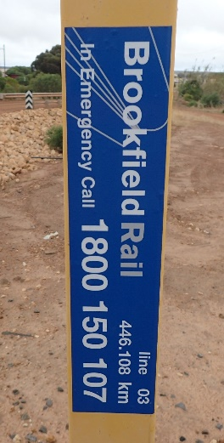
Example Photographs
Crossing Number/ID
Crossing Overview
Notes:
Left: Photo showing location cabinet displaying LX ID as well as a fault reporting phone line. Inset shows an example of an LX ID installed at a passive controlled crossing.
Right: Example crossing overview photo showing crossing controls on both approaches, track panel and hold points for both approaches.

Slide 54
Location 2 – S3 Position – Left Approach
Measure position of crossing control from outer rail
Measure position of hold line from outer rail
Determine the distance from the crossing control to the hold line to determine compliance to AS1742.7
Locate S3 point. (Location where a driver would be located when stopped at the hold line)
Measure available S3 sighting – UP direction
Measure available S3 sighting – DOWN direction
Measure proximity of structures within the rail corridor – both UP and DOWN directions
Measure whistle board location – both UP and DOWN directions
Notes:
Measurement is generally undertaken with a measuring wheel and measures the location of the crossing control from the nearest rail. AS1742.7 minimum measurement is 3.5m. Note: Control positions needs to be measured @ 90 degrees to the outer rail in assessing conformance to AS1742.7 (not all crossings are square)
Measurement is generally undertaken with a measuring wheel and measures the distance of the hold line from the nearest rail. AS1742.7 minimum measurement is 3.5m for passive controls or 3m from crossing control for actively controlled crossings. For skewed crossings, this distance is the shortest distances along the road between the nearest rail and the rear of the hold line. Note: Hold point positions are measured to the centre of the crossing parallel to the centre of the road, which for skewed crossings is not the nearest rail.
S3 Point is defined as the point at which a driver will be located at when stopped at the Hold Line. As a general guide, this point can be considered to be;
a. 1.5m behind the hold line, or
b. 1.5m behind the control sign if no hold line is marked, or
c. 5m away from the nearest rail if no control sign or hold line is present.
Using range finding binoculars:
4. Measure the maximum available unobscured sighting distance from the S3 point along the track in an UP direction.
5. Measure the maximum available unobscured sighting distance from the S3 point along the track in a DOWN direction.
6. Measure the proximity of structures within the rail corridor in both an UP and DOWN direction.
Structures can include; Sidings or Shunting Yards, Points or Crossings, Platforms, Underbridges, Steep embankments of 3m+ in height, medium embankments, overbridge/tunnel
7. Where installed, measure the distance to whistle boards installed equivalent to the centre of the crossing for the crossing being assessed in both an UP and Down direction.

Slide 55
Example S3 Sighting
S3 Sighting – Left Approach Up Track
S3 Sighting – Left Approach Down Track
Notes:
Left: Example of S3 sighting in an UP track direction
Right: Example of S3 sighting in a DOWN track direction

Slide 56
Location 3 – S3 Grade Positions – Left Approach
Measure S3 road grades at 5m increments for length of longest permitted vehicle starting at the hold line
Notes:
As part of the planning required prior to undertaking an ALCAM assessment, the assessor is required to establish what the largest permitted road vehicle is to traverse the level crossing. Roads which are not RAV rated are accessible by as-of-right vehicles. A length of 20m is to be assumed for all as-of-right level crossings. S3 grade measurements are required to be taken at 5m increments over then length of the largest permitted vehicle beginning at the hold line. E.g.. 5 measurements for an as-of-right 20m vehicle or 9 measurements for a 36.5m Double Road Train.
Using a digital spirit level, starting at the hold line measure and record the road grade as a percentage at 5m increments over the length of the largest vehicle.

Slide 57
Location 4 – S1 Grade Positions – Left Approach
Using the appropriate S1 table (available within the Crossing Assessment Handbook), determine the preliminary S1 distance based on the 85th percentile speed, largest permitted vehicle, road surface treatment and an initial road grade of 0 percent.
Measure S1 grades over a minimum of four equal length increments (5 measurements) between the hold point and the preliminary S1 point.
Calculate the average S1 grade using the five measured grades.
Using the appropriate S1 table, the calculated average S1 grade, the 85th percentile speed, road surface treatment and the largest permitted vehicle, determine the S1 distance for the crossing.
Notes:
See example S1 table for an as-of-right vehicle on a sealed approach on the next slide
Using a digital spirit level, starting at the hold line measure and record the road grade as a percentage at a minimum of 5 locations equally spaced over the preliminary S1 length. Note: for low speed approaches, some of the previously measured S3 grades may also be recorded as S1 grades.
Calculate the average of the S1 grades just measured and record on the data collection sheet.
Using the calculated average S1 grade, refer to the appropriate S1 table to determine the S1/SSD distance for the crossing.

Slide 58
Example S1 Table
Level 1 Semi-Trailer 20m lg & Level 2a B-Double 26m lg |  |  |  |  |  |  |  |  |  |  |  |  |  |  | Sealed Road
85% speed | Approach Grade (%)
 | -14% | -13% | -12% | -11% | -10% | -9% | -8% | -7% | -6% | -5% | -4% | -3% | -2% | -1% | 0% | 1% | 2% | 3% | 4% | 5% | 6% | 7% | 8% | 9% | 10% | 11% | 12% | 13% | 14%
10 | 14 | 14 | 13 | 13 | 13 | 13 | 13 | 13 | 13 | 13 | 13 | 13 | 13 | 13 | 13 | 12 | 12 | 12 | 12 | 12 | 12 | 12 | 12 | 12 | 12 | 12 | 12 | 12 | 12
20 | 31 | 30 | 30 | 29 | 29 | 28 | 28 | 28 | 28 | 27 | 27 | 27 | 27 | 26 | 26 | 26 | 26 | 26 | 26 | 25 | 25 | 25 | 25 | 25 | 25 | 25 | 25 | 25 | 25
30 | 53 | 52 | 50 | 49 | 48 | 48 | 47 | 46 | 45 | 45 | 44 | 44 | 43 | 43 | 42 | 42 | 42 | 41 | 41 | 41 | 41 | 40 | 40 | 40 | 40 | 39 | 39 | 39 | 39
40 | 80 | 77 | 75 | 74 | 72 | 70 | 69 | 68 | 67 | 66 | 65 | 64 | 63 | 62 | 61 | 61 | 60 | 59 | 59 | 58 | 58 | 57 | 57 | 57 | 56 | 56 | 55 | 55 | 55
50 | 112 | 108 | 105 | 102 | 99 | 97 | 95 | 93 | 91 | 89 | 88 | 87 | 85 | 84 | 83 | 82 | 81 | 80 | 79 | 78 | 77 | 77 | 76 | 75 | 75 | 74 | 74 | 73 | 72
60 | 148 | 143 | 139 | 134 | 131 | 127 | 124 | 121 | 119 | 117 | 114 | 112 | 110 | 109 | 107 | 106 | 104 | 103 | 102 | 100 | 99 | 98 | 97 | 96 | 95 | 94 | 94 | 93 | 92
70 | 190 | 183 | 177 | 171 | 166 | 161 | 157 | 153 | 150 | 147 | 144 | 141 | 138 | 136 | 134 | 132 | 130 | 128 | 126 | 125 | 123 | 122 | 120 | 119 | 118 | 117 | 115 | 114 | 113
80 | 237 | 227 | 219 | 212 | 205 | 199 | 194 | 189 | 184 | 180 | 176 | 173 | 169 | 166 | 163 | 161 | 158 | 156 | 153 | 151 | 149 | 147 | 146 | 144 | 142 | 141 | 139 | 138 | 137
90 | 302 | 288 | 277 | 266 | 257 | 248 | 241 | 234 | 228 | 222 | 217 | 212 | 207 | 203 | 199 | 195 | 192 | 189 | 186 | 183 | 180 | 178 | 175 | 173 | 171 | 169 | 167 | 165 | 163
100 | 361 | 345 | 330 | 317 | 306 | 296 | 286 | 278 | 270 | 263 | 256 | 250 | 245 | 239 | 234 | 230 | 226 | 222 | 218 | 215 | 211 | 208 | 205 | 202 | 200 | 197 | 195 | 192 | 190
110 | 426 | 406 | 389 | 373 | 359 | 347 | 335 | 325 | 316 | 307 | 299 | 292 | 285 | 279 | 273 | 267 | 262 | 257 | 253 | 249 | 245 | 241 | 237 | 234 | 231 | 228 | 225 | 222 | 219
120 | 496 | 472 | 452 | 433 | 417 | 402 | 388 | 376 | 365 | 354 | 345 | 336 | 328 | 321 | 314 | 307 | 301 | 295 | 290 | 285 | 280 | 276 | 271 | 267 | 264 | 260 | 256 | 253 | 250
Notes:
Example S1 table for an as-of-right vehicle on a sealed approach

Slide 59
Location 5 – S1/Safe Stopping Distance (SSD) Position – Left Approach
Measure to the S1/SSD point
Determine if the sighting is unobstructed for the full length back to the crossing controls from the SSD position.
Measure available S2 sighting and bearing – UP direction
Measure distance and bearing along the road back to the centre of the crossing
Measure available S2 sighting and bearing – DOWN direction
Notes:
From the preliminary S1 point, measure to the S1/SSD point
Standing at the S1/SSD point, look back towards the crossing and determine if the sighting back to the crossing controls is unobstructed for the full length back to the controls
Using range finding binoculars:
3. Measure the available S2 sighting distance and bearing in the UP direction
4. Measure the available sighting distance and bearing along the road to the centre of the crossing
5. Measure the available S2 sighting distance and bearing in the DOWN direction
Note: The available S2 sighting needs to consider if there are any sighting obstructions within the S2 triangle, i.e. sighting should be unobstructed along the full length of the road back to the controls, the length along the rail corridor to where a driver will first sight a train and the triangular area bound by these 2 distances.

Slide 60
Location 6 – S1/SSD Position – Left Approach
Take photograph of S2 – Up
Take photograph of S1 – Left Approach
Take photograph of S2 – Down
Notes:
Standing at the S1/SSD position, take photographs of;
The available S2 in the UP direction
The available S1 back to the centre of the crossing
The available S2 in the DOWN direction

Slide 61
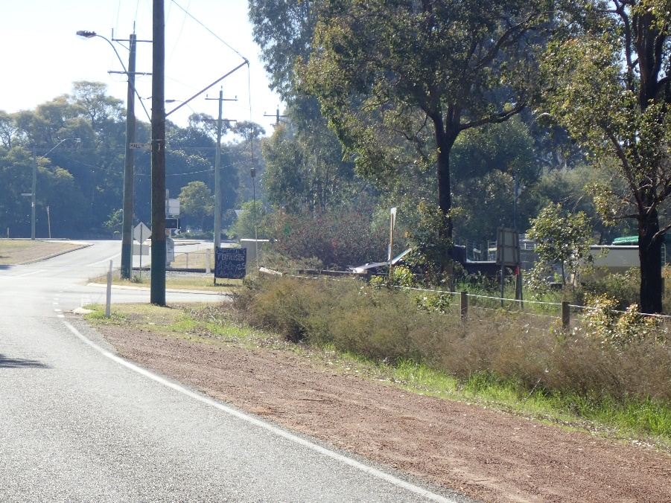
Example S1/S2 Sighting & Photographs
↓ S1 Sighting – Left Approach
↑ S2 Sighting – Left Approach Up Track
↑ S2 Sighting – Left Approach Down Track
Notes:
Left: Photo showing S2 sighting from a left approach looking in an UP direction
Centre: Photo showing S1 sighting from a left approach looking back to the crossing
Right: Photo showing S2 sighting from a left approach looking in a DOWN direction

Slide 62
Location 7 – Maximum SSD Position – Left Approach
Determine and measure out to the Maximum Available SSD point
Note: Where a crossing does not have the required S1/SSD due to sighting obstructions or constraints, then the maximum SSD position will be less than the calculated S1/SSD.
Notes:
From the S1/SSD point, measure along the roadway out to the point of maximum achievable SSD and record this distance on your Data Collection Sheet.

Slide 63
Location 8 – Signage/Pavement Marking Positions – Left Approach
On the return back to the crossing, photograph and measure the location of advanced warning signage and pavement markings making notes on your Data Collection Sheet of all photographs taken and recording all measurements taken on the Site Sketch.
Take photograph of crossing controls on Left Approach
Notes:
Whilst making your way back to the crossing, take a photograph and record the location as a distance from the crossing of any advanced warning signage or pavement markings on your site sketch.
On returning to the crossing, take a photo of the crossing controls from the left approach, being sure to include the hold line and controls in the same photo.
Note: To determine compliance with AS1742.7, advanced warning signage and pavement markings are measured relative to the crossing hold line. For ease of assessment, in the field these items are measured from the outer rail with the hold line distance subtracted from the field measurement.

Slide 64
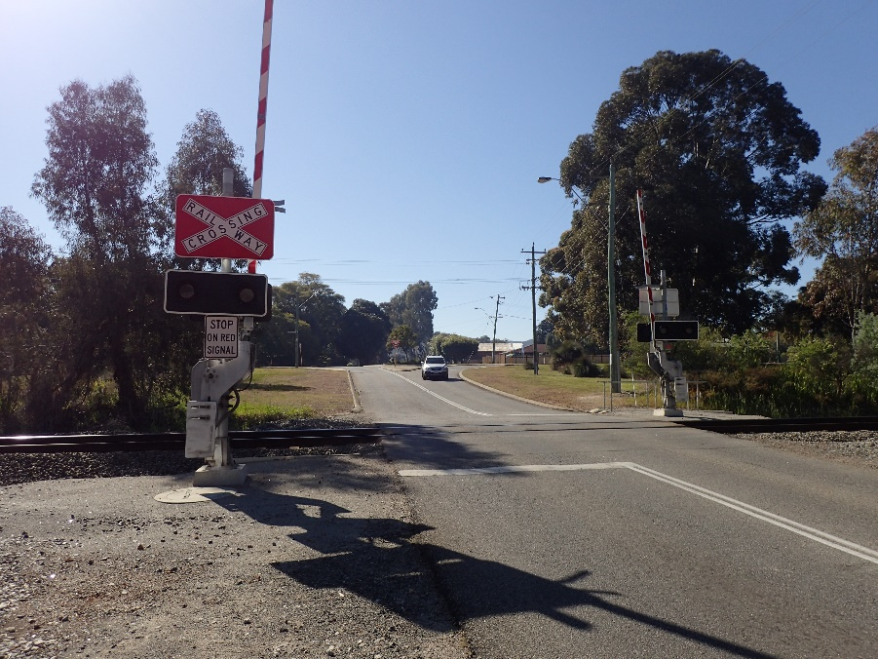
Example Photographs
↓ Advanced Warning – Pavement Marking
↑ Advanced Warning - Signage
↑ Crossing Controls
Notes:
Left: Photo showing advanced warning signage (W7-4)
Centre: Photo showing advanced warning RAIL X pavement markings
Right: Photo showing left approach crossing controls, including hold line

Slide 65
Location 9 – S3 Position – Left Approach
Locate S3 point
Take photograph of S3 – Up direction
Take photograph of S3 – Across Track (capture hold line in photo if present)
Take photograph of S3 – Down direction
Notes:
Move to the S3 point (same point as S3 sighting measurements were previously taken)
Take a photograph of the available S3 sighting in an UP direction
Take a photograph across the crossing from the S3 point of the left approach ensuring to capture the hold line when one is present.
Take a photograph of the available S3 sighting in a DOWN direction

Slide 66
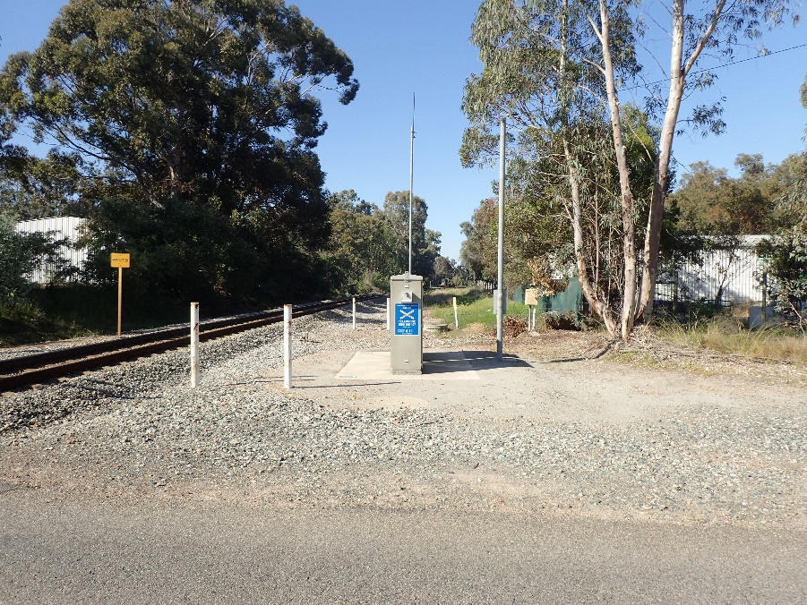
Example S3 Sighting Photographs
↓ S3 Sighting – Left Approach
↑ S3 Sighting – Left Approach Up Track
↑ S3 Sighting – Left Approach Down Track
Notes:
Left: Photo showing S3 sighting from a left approach looking in an UP direction
Centre: Photo showing S3 sighting from a left approach looking across the crossing
Right: Photo showing S3 sighting from a left approach looking in a DOWN direction

Slide 67
Location 10 – Track Panel
Ensure that it is safe to enter the Danger Zone
Move to a position up track of the crossing where facing in a down direction a photograph of the entire crossing surface panel can be taken.
Move to a position down track of the crossing where facing in an up direction a photograph of the entire crossing surface panel can be taken.
Notes:
Field staff must never enter the rail corridor without the approval of the RIM. If approval to enter the rail corridor, including the Danger Zone, has been given, field staff must abide by the RIM’s safety and other requirements as applicable. Prior to entering the Danger Zone, ensure that it is safe to do so. The use of a lookout is recommended.
Move to a position approximately 4-5m UP track from the crossing panel and take a photograph of the track panel facing in a DOWN direction. You should be positioned in a location where your photograph captures the entire crossing panel surface.
Move to a position approximately 4-5m DOWN track from the crossing panel and take a photograph of the track panel facing in an UP direction. You should be positioned in a location where your photograph captures the entire crossing panel surface.

Slide 68
Example Photographs
Up Track
Down Track
Notes:
Left: Photo showing crossing panel looking in an UP direction
Right: Photo showing crossing panel looking in a DOWN direction

Slide 69
Location 11 – S3 Position – Right Approach
Locate S3 point
Take photograph of S3 – Up direction
Take photograph of S3 – Across Track (capture hold line in photo if present)
Take photograph of S3 – Down direction
Take photograph of crossing controls on Right Approach
Notes:
Move to the S3 point (same point as S3 sighting measurements were previously taken)
Take a photograph of the available S3 sighting in an UP direction
Take a photograph across the crossing from the S3 point of the left approach ensuring to capture the hold line when one is present.
Take a photograph of the available S3 sighting in a DOWN direction

Slide 70
Location 12 – S3 Position – Right Approach
Measure position of crossing control from outer rail
Measure position of hold line from outer rail
Locate S3 point. (Location where a driver would be located when stopped at the hold line)
Measure available S3 sighting – UP direction
Measure available S3 sighting – DOWN direction
Measure proximity of structures within the rail corridor – both UP and DOWN directions
Notes:
Measurement is generally undertaken with a measuring wheel and measures the location of the crossing control from the nearest rail. AS1742.7 minimum measurement is 3.5m. Note: Control positions needs to be measured @ 90 degrees to the outer rail in assessing conformance to AS1742.7 (not all crossings are square)
Measurement is generally undertaken with a measuring wheel and measures the distance of the hold line from the nearest rail. AS1742.7 minimum measurement is 3.5m for passive controls or 3m from crossing control for actively controlled crossings. For skewed crossings, this distance is the shortest distances along the road between the nearest rail and the rear of the hold line. Note: Hold point positions are measured to the centre of the crossing parallel to the centre of the road, which for skewed crossings is not the nearest rail.
S3 Point is defined as the point at which a driver will be located at when stopped at the Hold Line. As a general guide, this point can be considered to be;
a. 1.5m behind the hold line, or
b. 1.5m behind the control sign if no hold line is marked, or
c. 5m away from the nearest rail if no control sign or hold line is present.
Using range finding binoculars:
4. Measure the maximum available unobscured sighting distance from the S3 point along the track in an UP direction.
5. Measure the maximum available unobscured sighting distance from the S3 point along the track in a DOWN direction.

Slide 71
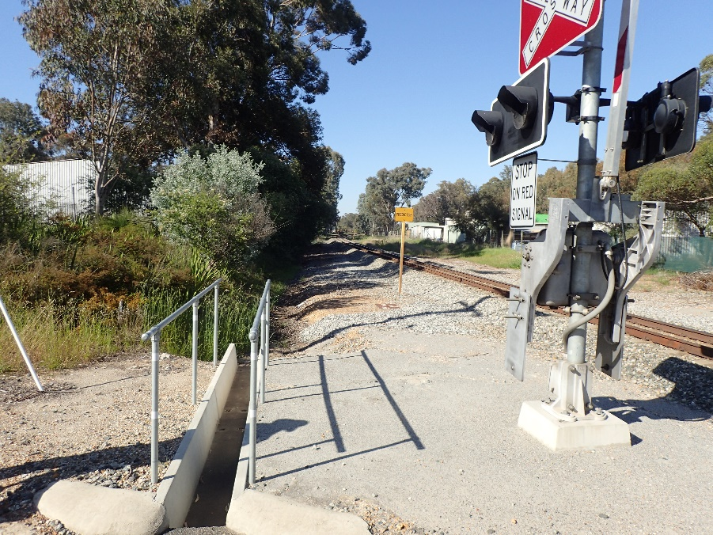
Example S3 Sighting Photographs
↓ S3 Sighting – Right Approach
↑ S3 Sighting – Right Approach Up Track
↑ S3 Sighting – Right Approach Down Track
Notes:
Left: Photo showing S3 sighting from a right approach looking in an UP direction
Centre: Photo showing S3 sighting from a right approach looking across the crossing
Right: Photo showing S3 sighting from a right approach looking in a DOWN direction

Slide 72
Location 13 – S3 Grade Positions – Right Approach
Measure S3 road grades at 5m increments for length of longest permitted vehicle starting at the hold line
Using the S3 road grade measured at the hold point here on the right approach and the S3 road grade previously measured at the hold point on the left approach, determine the vertical profile of the crossing to establish if the crossing is level, on a hump or in a dip.
Notes:
As part of the planning required prior to undertaking an ALCAM assessment, the assessor is required to establish what the largest permitted road vehicle is to traverse the level crossing. Roads which are not RAV rated are accessible by as-of-right vehicles. A length of 20m is to be assumed for all as-of-right level crossings. S3 grade measurements are required to be taken at 5m increments over then length of the largest permitted vehicle beginning at the hold line. E.g.. 5 measurements for an as-of-right 20m vehicle or 9 measurements for a 36.5m Double Road Train.
Using a digital spirit level, starting at the hold line measure and record the road grade as a percentage at 5m increments over the length of the largest vehicle.
On each side of the crossing, take point grades at the hold line, add the 2 grades together to determine the vertical profile of the crossing.
Combined grade is <8% = level
Combined grade ≥8% and <12% = minor hump
Combined grade is ≥12% = major hump
≤-10% on any one side or combined grade ≤-12% = dip

Slide 73
Location 14 – S1 Grade Positions – Right Approach
Using the appropriate S1 table, determine the preliminary S1 distance based on the 85th percentile speed, largest permitted vehicle, road surface treatment and an initial road grade of 0 percent.
Measure S1 grades over a minimum of four equal length increments (5 measurements) between the hold point and the preliminary S1 point.
Calculate the average S1 grade using the five measured grades.
Using the appropriate S1 table, the calculated average S1 grade, the 85th percentile speed, road surface treatment and the largest permitted vehicle, determine the S1 distance for the crossing.
Notes:
See example S1 table for an as-of-right vehicle on a sealed approach on the next slide
Using a digital spirit level, starting at the hold line measure and record the road grade as a percentage at a minimum of 5 locations equally spaced over the preliminary S1 length. Note: for low speed approaches, some of the previously measured S3 grades may also be recorded as S1 grades.
Calculate the average of the S1 grades just measured and record on the data collection sheet.
Using the calculated average S1 grade, refer to the appropriate S1 table to determine the S1/SSD distance for the crossing.

Slide 74
Location 15 – S1/SSD Position – Right Approach
Measure to the S1/SSD point
Determine if the sighting is unobstructed for the full length back to the crossing controls from the SSD position.
Measure available S2 sighting and bearing – UP direction
Measure distance and bearing along the road back to the centre of the crossing
Measure available S2 sighting and bearing – DOWN direction
Notes:
From the preliminary S1 point, measure to the S1/SSD point
Standing at the S1/SSD point, look back towards the crossing and determine if the sighting back to the crossing controls is unobstructed for the full length back to the controls
Using range finding binoculars:
3. Measure the available S2 sighting distance and bearing in the UP direction
4. Measure the available sighting distance and bearing along the road to the centre of the crossing
5. Measure the available S2 sighting distance and bearing in the DOWN direction
Note: The available S2 sighting needs to consider if there are any sighting obstructions within the S2 triangle, i.e. sighting should be unobstructed along the full length of the road back to the controls, the length along the rail corridor to where a driver will first sight a train and the triangular area bound by these 2 distances.

Slide 75
Location 16 – S1/SSD Position – Right Approach
Take photograph of S2 – Up direction
Take photograph of S1 – Left Approach
Take photograph of S2 – Down direction
Notes:
Standing at the S1/SSD position, take photographs of;
The available S2 in the UP direction
The available S1 back to the centre of the crossing
The available S2 in the DOWN direction

Slide 76
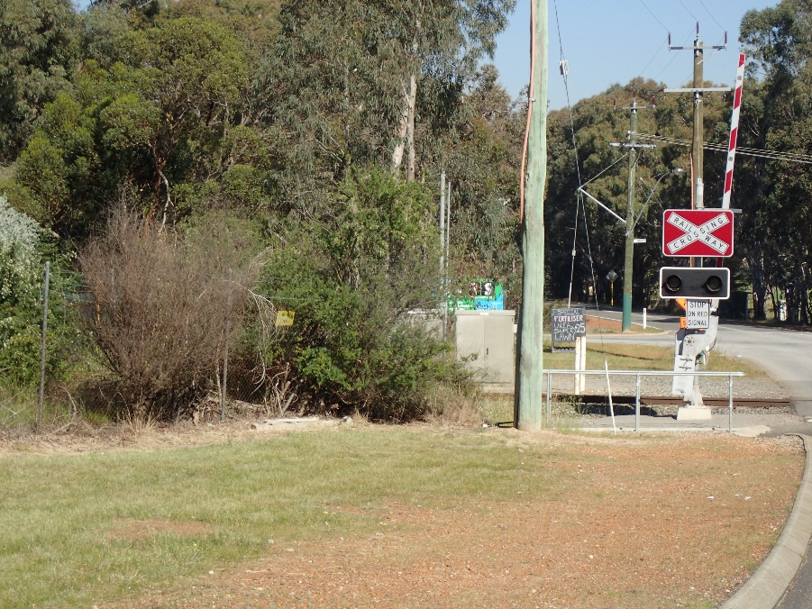
Example S1/S2 Sighting & Photographs
↓ S1 Sighting – Right Approach
↑ S2 Sighting – Right Approach Up Track
↑ S2 Sighting – Right Approach Down Track
Notes:
Left: Photo showing S2 sighting from a right approach looking in an UP direction
Centre: Photo showing S1 sighting from a right approach looking back to the crossing
Right: Photo showing S2 sighting from a right approach looking in a DOWN direction

Slide 77
Location 17 – Maximum SSD Position – Right Approach
Determine and measure out to the Maximum Available SSD point
Notes:
1. From the S1/SSD point, measure along the roadway out to the point of maximum achievable SSD and record this distance on your Data Collection Sheet.

Slide 78
Location 18 – Signage/Pavement Marking Positions – Right Approach
On the return back to the crossing, photograph and measure the location of advanced warning signage and pavement markings making notes on your Data Collection Sheet of all photographs taken and recording all measurements taken on the Site Sketch.
Notes:
Whilst making your way back to the crossing, take a photograph and record the location as a distance from the crossing of any advanced warning signage or pavement markings on your site sketch.
Note: To determine compliance with AS1742.7, advanced warning signage and pavement markings are measured relative to the crossing hold line. For ease of assessment, in the field these items are measured from the outer rail with the hold line distance subtracted from the field measurement.

Slide 79
Additional Information
On returning to the crossing location, there are a number of items of additional information which require completing.
Road Profile:
Determine the vertical profile of the road by adding the hold line grades from each approach together and referring to the below table;
Road Surface Information:
Complete the Road Surface Information section of the Data Collection Sheet for the Immediate and Extended Approaches on both the Left and Right approaches.
Grade | Road Profile
<8% | Level
≥8% and <12% | Minor Hump
≥12% | Major Hump
≤-10% on any one side or combined grade ≤-12% | Dip

Slide 80
Additional Approaches
Some level crossing locations may have approaches other than the primary left and right approaches. Usually these approaches are side roads or junctions adjoining the primary approach roads.
Where these additional approaches have a unique S1/SSD point which is not located on the primary approaches, these additional approaches need to be assessed in the same manner as the primary approaches.
Where the S1/SSD point for this additional approach is located on the primary approach and within the primary approach’s S1/SSD point, then this approach only needs to be considered for compliance with AS1742.7. i.e. advanced warning installed and positioned correctly.

Slide 81
Location 19 – S1 Grade Positions – Additional Approaches with a unique S1/SSD point
Using the appropriate S1 table, determine the preliminary S1 distance based on the 85th percentile speed, largest permitted vehicle, road surface treatment and an initial road grade of 0 percent.
Measure S1 grades over a minimum of four equal length increments (5 measurements) between the hold point and the preliminary S1 point. Some of these measurement locations may be the same as locations used for the primary approach.
Calculate the average S1 grade using the five measured grades.
Using the appropriate S1 table, the calculated average S1 grade, the 85th percentile speed, road surface treatment and the largest permitted vehicle, determine the S1 distance for the crossing.
Notes:
See example S1 table for an as-of-right vehicle on a sealed approach on the next slide
Using a digital spirit level, starting at the hold line measure and record the road grade as a percentage at a minimum of 5 locations equally spaced over the preliminary S1 length. Note: Some of these measurement locations may be the same as locations used for the primary approach.
Calculate the average of the S1 grades just measured and record on the data collection sheet.
Using the calculated average S1 grade, refer to the appropriate S1 table to determine the S1/SSD distance for the crossing.
Note: For vehicles approaching from an additional approach, the 85th percentile speed is the higher of:
a. The speed of the vehicle when it completes the turn from the side road towards the crossing and the driver first recognises the crossing controls or
b. The accelerated speed from this intersection point travelling towards the crossing when the driver first recognises the crossing controls.

Slide 82
Location 20 – S1/SSD Position – Additional Approaches with a unique S1/SSD point
Measure to the S1/SSD point
Determine if the sighting is unobstructed for the full length back to the crossing controls from the SSD position.
Measure available S2 sighting and bearing – UP direction
Measure distance and bearing along the road back to the centre of the crossing
Measure available S2 sighting and bearing – DOWN direction
From the S1/SSD point, measure along the roadway out to the point of maximum achievable SSD and record this distance on your Data Collection Sheet.
Notes:
From the preliminary S1 point, measure to the S1/SSD point
Standing at the S1/SSD point, look back towards the crossing and determine if the sighting back to the crossing controls is unobstructed for the full length back to the controls
Using range finding binoculars:
3. Measure the available S2 sighting distance and bearing in the UP direction
4. Measure the available sighting distance and bearing along the road to the centre of the crossing
5. Measure the available S2 sighting distance and bearing in the DOWN direction
6. From the S1/SSD point, measure along the roadway out to the point of maximum achievable SSD and record this distance on your Data Collection Sheet.

Slide 83
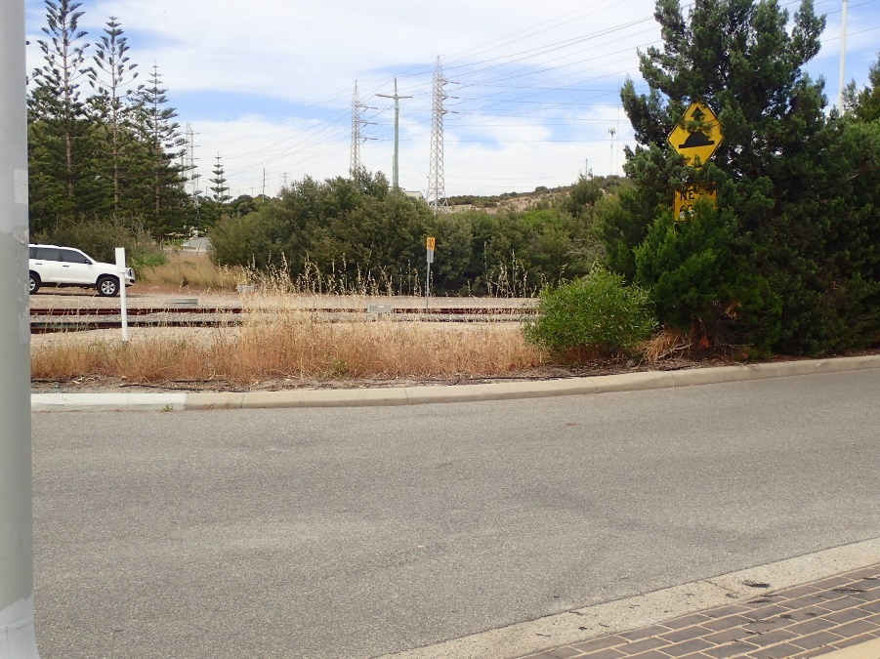
Example S1/S2 Sighting & Photographs
↓ S1 Sighting – Additional Approach
↑ S2 Sighting – Additional Approach Up Track
↑ S2 Sighting – Additional Approach Down Track
Notes:
Left: Photo showing S2 sighting from the additional approach looking in an UP direction
Centre: Photo showing S1 sighting from the additional approach looking back to the crossing
Right: Photo showing S2 sighting from the additional approach looking in a DOWN direction

Slide 84
Location 21 – S1/SSD Position – Additional Approaches with a unique S1/SSD point
Take photograph of S2 – Up direction
Take photograph of S1 – Left Approach
Take photograph of S2 – Down direction
Notes:
Standing at the S1/SSD position, take photographs of;
The available S2 in the UP direction
The available S1 back to the centre of the crossing
The available S2 in the DOWN direction

Slide 85
Location 22 – Maximum SSD Position – Additional Approaches with a unique S1/SSD point
Determine and measure out to the Maximum Available SSD point
Notes:
1. Continuing from the S1/SSD point, measure along the roadway out to the point of maximum achievable SSD and record this distance on your Data Collection Sheet.

Slide 86
Location 23 – Signage/Pavement Marking Positions – Additional Approaches with a unique S1/SSD point
On the return back to the intersection, photograph and measure the location of advanced warning signage and pavement markings making notes on your Data Collection Sheet of all photographs taken and recording all measurements taken on the site sketch.
Take a photograph of the intersection controls for this additional approach
On the return back to the crossing, measure the distance from the intersection back to the crossing, record this measurement on the site sketch.
Notes:
Whilst making your way back to the intersection of the primary approach and this additional approach, take a photograph and record the location as a distance from the intersection of any advanced warning signage or pavement markings on your site sketch.
On returning to the intersection, take a photo of the intersection controls.
On the return back to the crossing, measure the distance from the intersection back to the crossing, record this measurement on the site sketch.

Slide 87
Control Points
Control points are road intersections or road pedestrian crossing facilities that exist close to an exit from a level crossing, and do not give priority to exiting vehicles.
A control point is not necessarily a controlled or uncontrolled side road but depends on the effect an intersection has on traffic exiting the level crossing.
Notes:
A control point is a:
• Closed gate — a gate on the exit from the level crossing which is kept closed and must be opened by the user.
• Controlled intersection — a road intersection on the exit from the level crossing which is equipped with active traffic signals, or passive controls that may cause the exiting road vehicle to need to stop.
• Controlled pedestrian crossing — a pedestrian crossing on the exit roadway which is equipped with active traffic signals or passive signage (e.g. zebra crossings, school crossings) that may cause the exiting road vehicle to need to stop.
• Uncontrolled crossroad — a crossroad not equipped with any controls to which the road vehicle may need to give way to the right for opposing traffic.
• Uncontrolled T-intersection — a T-intersection not equipped with any controls where the exiting road is on the terminating leg of the T and the road vehicle must turn left or right, giving way to traffic.

Slide 88
Location 24 – Control Point Positions
Measure from the outer rail to the closest control point on each side of the crossing.
Record the type of control point is being measured to
For a controlled intersection, measure to the Stop/Give Way hold line. If no hold line is present then measure to the control sign.
For an uncontrolled intersection, measure to the extension of the edge of the intersecting road.
Control points only need to be measured & recorded if they are located within 400m of the level crossing exit on sealed roads, or within 200m on unsealed roads.
Note: Where a control point distance is less than the length of the largest vehicle plus 5m, then Short Stacking is present.
Notes:
This distance is recorded if a road intersection or road pedestrian crossing facility is within 400m of the level crossing exit for sealed roads, or within 200m for unsealed roads.
If there are multiple control points, record the one closest to the crossing on each side.

Slide 89
Photo Naming Conventions
The use of a standard naming convention for photographs, which includes a standard naming of approach quadrants is recommended. This has the advantage that users of the data can tell by the name of the photograph from which direction and orientation it was taken.
Jurisdictions or organisations may have existing photo naming conventions in place, the table to the right is an example of a naming convention used by some jurisdictions/organisations.
Standard Name | Description
LX52.770km_ID | Crossing Name and Number
LX52.770km_Overview | General overview of crossing
LX52.770km_S2LU | From the S1/SSD point on the left approach facing Up Direction
LX52.770km_S1LA | From the S1/SSD point on the left approach facing to crossing
LX52.770km_S2LD | From the S1/SSD point on the left approach facing Down Direction
LX52.770km_PL | Crossing protection on left road approach
LX52.770km_S3LU | From the S3 point on the left approach sighting Up Direction
LX52.770km_S3LA | From the S3 point on the left approach facing across crossing
LX52.770km_S3LD | From the S3 point on the left approach sighting Down Direction
LX52.770km_TD | View across crossing in Down Direction
LX52.770km_TU | View across crossing in Up Direction
Notes:
An automated process of renaming photographs may be used. Use of such a system is most efficient where the standard photographs are taken in order on-site but renaming (and therefore reordering) can be achieved in the office after the event if necessary. For efficiency, the order of photographs taken should minimise the distance travelled on-site by the photographer.
The choice of whether to use a photograph naming convention and which one to use will be made by the jurisdiction and will balance field efficiency with the long-term usefulness of the data.
If a naming convention is not used, the assessor must show the photo number and direction on the site sketch.

Slide 90
Crossing Control Measures
An essential part of an ALCAM assessment is to observe and record all crossing control measures installed at a crossing for both the left & right approaches. These crossing control measures include items such as the primary crossing controls, additional crossing controls and advance warning devices.

Slide 91
Primary Crossing Controls
The primary crossing controls are the controls which are installed at the crossing location and include;
Full Boom Flashing Lights
Half Boom Flashing Lights
Primary Flashing Lights
Stop Signs
Give Way Signs
At level crossing sites which have the above controls installed on both sides of the roadway and on both approaches, then the controls are considered to be duplicated.
The primary crossing controls observed at the crossing are to be recorded on the data collection sheet. Note: Only one primary crossing control should be recorded.
Notes:
Note:
1. Rear facing or backing lights installed on the crossing controls on the departure side of the crossing (as per the included image) are not considered to be duplicated controls.
Controls are only considered to be duplicated when crossing controls are installed on both sides of the road way. i.e. RX-5 assemblies on both the left hand and right hand side of the road for both approaches.
2. There may be occasions at passively controlled crossings where the controls differ on each approach. i.e. Give-way signs on one approach and Stop signs on the other approach.

Slide 92
Additional Crossing Controls
Additional crossing controls which may be installed at the crossing location include;
Bells/Audible Warning Devices
‘Keep Tracks Clear’ Signage
‘Keep Tracks Clear’ Signage And Yellow Box Marking
Backing Boards/LED Lights
Hump/Dip Advisory Signage
R6-25 Signage
Train Speed Advisory Signage For Road Users
Train Activated Strobe Lights
Short Stacking Signage
Overhead Mounted Traffic Controls
RX-9 Crossing Width Marker Assemblies
Additional crossing controls observed at the crossing are to be recorded on the data collection sheet. Note: Multiple additional crossing controls may be recorded.

Slide 93
Advance Warning Devices
Advance warning devices which may be installed at the crossing location include;
Single Standard Advanced Warning
Duplicated Standard Advanced Warning
Single Train Activated Advance Warning (e.g. AAWA)
Duplicated Train Activated Advance Warning
Single Large Passive Advance Warning
Duplicated Large Passive Advance Warning
Vehicle Activated Advance Warning (e.g. Strobe Lights)
Passive Tactile Advance Warning (e.g. Rumble Strip)
Passive Visual Advance Warning (e.g. Stripes)
‘RAIL-X’ Pavement Marking
Notes:
Advance warning devices observed at the crossing are to be recorded on the data collection sheet.
Note: Multiple advance warning devices may be recorded and advanced warning installations may differ from one approach to the other, this should be recorded.

Slide 94
Other Control Measures
Other control measures which may be present at the crossing location and which need to be recorded include;
Human Factors
Localised Public Education Strategies, Red Light Cameras, CCTV Surveillance, Hand Signallers, Public Response Phone Number
Train Related
Reschedule Train to Avoid Conflict, Whistle Boards, Reduce Train Speed (to achieve S2/S3)
Crossing Environment
Street Lighting at Crossing, Maintenance Programme for Vegetation etc.
Road Works
Central Barrier Posts/Median on Road Approach, Vehicle Escape Zones
Signalling/Detection Systems
Control of Crossing (CCTV or On Site), Coordinate With Adjacent Traffic Signals, Sign (Active) For Second Oncoming Train Warning, Detectors in Crossing Conflict Zone, Road Traffic Signals (Active) – Secondary Control, Healthy State Monitoring, Queue Relocation

Slide 95
Measurement Methods & Devices
When undertaking an ALCAM assessment, there are a variety of ways to undertake field measurements.
Notes:
Distribute Road form

Slide 96
Range Finding Binoculars
Distances to distant or inaccessible objects can be measured quickly and accurately with the use of laser range finding binoculars.
The precision of range finding binoculars varies, and the manufacturer’s specifications should be consulted to ensure the measurement precision is adequate. A precision of +/– 0.5% is considered adequate for the measurement of the approach signage position and sighting distances.
Some range finding binoculars are also equipped with an electronic compass for the measurement of bearings and/or angles. When utilising this feature, be aware of the potential for magnetic interference from rails, overhead wiring and other metal objects in the vicinity.
Notes:
When taking measurements using range finding binoculars, consider:
The object being measured must be correctly acquired by the instrument.
At least three measurements should be taken to ensure that a repeatable dimension is obtained.
Where the background or foreground contains obstructions which may reflect the rangefinder’s infrared signal, a measurement may be returned for the wrong object. Take comparative measurements on other nearby objects offering clear sighting as a quick check on the distances measured.
Some instruments require a larger reflecting area, and it may be difficult to accurately measure an object such as a person at longer distances.
Varying the point of aim slightly each time may show errors in spotting a target.
Raindrops will refract and reflect the signal and can produce incorrect results.
For accurate measurement to distant objects the binoculars can be mounted on a tripod, or the operator can lean against a fixed object to achieve steady sighting.

Slide 97
Measuring Wheel
Commonly available, easily portable measuring wheels provide a ready means of measuring distances on roadways to a precision of 0.1m, which is considered adequate for nearly all dimensions required by ALCAM.
For safety and to avoid interfering with signalling circuits, use a rubber-wheeled measuring wheel when measuring across tracks.
Measuring wheels have the advantage of being able to be used by a single operator. The wheel should be rolled directly along the line being measured without wandering, as this would increase the distance being measured.

Slide 98
Digital Spirit Level
A digital spirit level can provide a digital readout of slope to indicate whether the road surface is relatively flat or on a slope. It can be used to measure an instantaneous slope at a point on the road.
Digital spirit levels are easily portable and capable of measuring to the required accuracy.
Notes:
The disadvantage of digital spirit levels is that they measure over a short base and are therefore considerably affected by small variations in the pavement or road surface. It is therefore important to take several measurements within the zone being measured to obtain a reasonably accurate average grade.
The road gradient over the length of a vehicle (approximately 20m, depending on the longest vehicle using the crossing) is required to provide an S3 grade. While this can be measured using an automatic level in one measurement, it is possible to achieve a reasonable approximation of the average grade by taking and averaging a series of grade measurements using a digital spirit level. Averaging the measurements taken every 5m from the crossing control assembly over the length of the vehicle should be sufficient for this purpose.

Slide 99
Tape Measure
Tape measures may be used to measure short distances, such as the spacing between tracks, carriageway widths, flange-way gaps and depths. Tape measures generally require two operators.
Metal tape measures must not be used in the vicinity of live overhead wiring or when measuring across circuited tracks. As well as being a safety risk, this may interfere with signalling circuits.

Slide 100
Geographical Information System
A Geographical Information System (GIS) can be used to measure position, horizontal distance and bearing or angle. GIS include Google Earth and other similar mapping products.
Whilst this method of measurement is not as accurate the other methods listed above, it may be adequate for the purpose where measurement on site is not possible, providing that the accuracy and limitations of the data are understood.
Notes:
While this method may be more efficient than direct measurement in the field, and GIS may supply mapping and aerial photography data of sufficient accuracy to allow some co-ordinates to be taken or measurements to be scaled; the scale and integrity of the data is variable. Furthermore, this may introduce indeterminate errors into the measurement. The age of the GIS data may also be an issue if ground features have changed since the data was gathered.

Slide 101
Vehicle Mounted Inclinometer
Calibrated vehicle mounted inclinometers which are capable of an accuracy of 0.1% or better can be fitted to motor vehicles to measure grades.
A calibrated vehicle mounted inclinometer when combined with a calibrated vehicle mounted tripmeter can be used for the measuring of road grades which are often at some distance from the crossing and would require significant walking time if measured with a digital spirit level or optical level and measuring wheel.

Slide 102
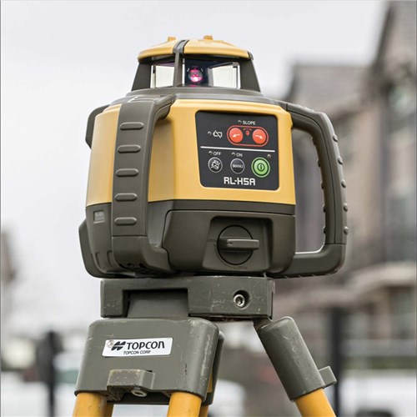
Optical or Laser Level
An optical or laser level may be used to measure grade.
The average slope over a given distance can be calculated by measuring the difference in height between two points a known distance apart.
The height distance can be measured with a low order optical level such as an “automatic” level, a transit level locked horizontally, or a laser level. The choice of instrument will depend on its practicality and time taken in the field.
Notes:
The instrument is set up level using a spirit level bubble. Sighting is to a graduated staff to measure the distance from the ground to the instrument’s level plane, either by reading the staff through the instrument’s telescope (automatic level) or by moving the laser sensor on the staff. A staff measurement is taken at either end of the grade to be measured. The difference between the two measurements is the fall or rise in the road. Dividing it by the horizontal distance between the two points and multiplying it by 100 yields the grade as a percentage.
This measurement has the advantage that minor irregularities in the pavement have less effect on the measured grade.

Slide 103
Vehicle Mounted Tripmeter
A motor vehicle’s own odometer is generally not precise enough to be used for crossing measurements. More precise calibrated odometers or tripmeters which are capable of an accuracy of 1m or better can be fitted to motor vehicles and display measured distances.
The accuracy of a calibrated tripmeter is suitable for measuring distances to advance warning signage and other features which are often at some distance from the crossing and would require significant walking time if measured with a measuring wheel.

Slide 104
GPS Receiver
A GPS receiver can provide latitude and longitude coordinates of the crossing to within a few metres or less, depending on factors such as the quality of the equipment, the number of satellite signals being used and the location of overhead obstructions such as vegetation or structures within the vicinity of the crossing.
A GPS receiver can also be used to measure horizontal distances and bearings through the use of waypoints.
Notes:
Coordinates are recorded as latitude and longitude in degrees, minutes and seconds of arc. A precision of one-tenth of a second of latitude and longitude is adequate to locate the crossing for mapping purposes and field location for emergency vehicles and other purposes.

Slide 105
Hand Bearing Compass
A hand bearing compass capable of being accurately aimed, such as a military or prismatic compass is ideal for measuring bearings.
The electronic compass built into some range finding binoculars provides a more accurate bearing, mainly due to its improved sighting arrangement rather than a more accurate compass.
Notes:
Note:
Be aware of the potential for magnetic interference from rails, overhead wiring and other metal objects in the vicinity.
Magnetic bearings must be corrected for magnetic declination to convert them to “true” bearings. This correction varies depending on location. The LXM software applies a correction for the magnetic declination in its sighting distance calculations.

Slide 106
Sighting Board
An option to help aid the measuring of S2 or S3 sight distances is the use of a sighting board. This can be useful for situations where:
• rests or dips in the landscape result in trains disappearing behind them,
• it is difficult to measure a distance, or
• low-lying vegetation would otherwise obscure the rail line itself (and possibly also the survey assistant).
Whether a sighting board is used or not may be left to the discretion of the field party or jurisdiction.
Extreme caution should be taken if there are overhead wires or structures. Approval from the appropriate RIM may be required to use a sighting board that extends close to or into any electrical exclusion zone.
Sighting boards should be of non-conductive materials and only be coloured the approved safety orange allowable in the corridor. Red or green must never be used.
Notes:
Sighting board height should be set to the height of the train (headlight) above the rails which is considered to be 4.0m for main line railway (3.6m in NZ) and 2.3m for cane railway as shown in AS 1742.7 (Appendix D5) and NZTA TCD Part 9. Some jurisdictions prefer to set this target height at 2.4m which approximates the train drivers’ eye height

Slide 107
Calibration
The accuracy of all measuring devices degrade over time. This is typically caused by normal wear and tear. The bottom line is that, calibration improves the accuracy of the measuring device. Accurate measuring devices improve data quality.
A measuring device should be calibrated:
According to recommendation of the manufacturer.
After any mechanical or electrical shock.
Periodically (annually, quarterly, monthly)
For instructions on how to calibrate your measuring devices, please refer to the manufacturer’s guidelines.

Slide 108
Site Sketch
A site sketch of the crossing must always be prepared as part of the site survey. The sketch does not need to be to scale but should be reasonably proportionate to illustrate the site, provided there is room to clearly add dimensions and other relevant information.
If suitable aerial photography or mapping is available this can be used as a basis for this sketch and may be prepared in the office prior to travelling to site. Where the site sketch is pre-prepared in the office, it should be ensured that the sketch is verified on site and all required information it included on the sketch.
At crossing sites that include pedestrian crossings, it is preferable to sketch each pedestrian crossing separately for clarity.

Slide 109
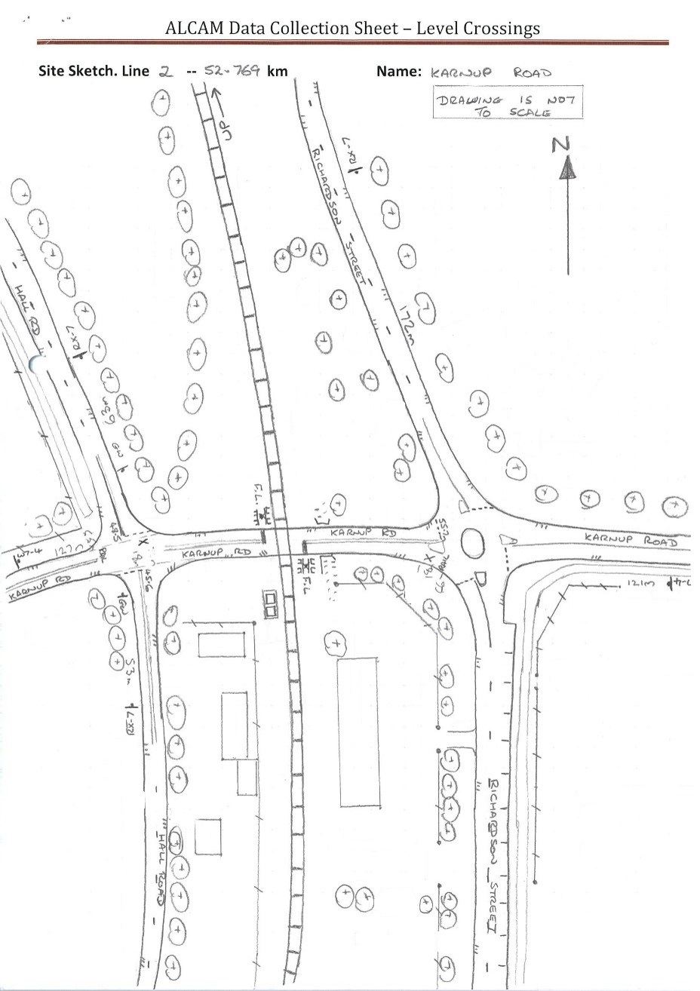
Site Sketch Information
The site sketch should be a clear and legible plan view of the crossing and include the following:
Crossing details – ID number, line/branch name and rail kilometrage.
Type of crossing – public, private, pedestrian.
Date of the site survey to which the sketch relates.
The Up direction & north point.
All road names.
The location and alignment of all railway tracks in the vicinity of the crossing.
The road approach alignment, including any other roads or intersections within the crossing approach and their distances from the crossing.
All crossing signage and road markings
Any features in the vicinity of the crossing which effect approach visibility
Any other significant features which will be shown on site photographs.
Dimensions relative to the outside rail of crossing control, stop lines and advanced warnings.
Carriageway width and number of lanes.
Notes:
The site sketch should be orientated in such a way to ensure that the required information is presented in a clear & legible manner.
For sites with single approaches and as a ALCAM field survey is predominantly road based, the orientation of the site sketch recommended is with the sketch drawn in portrait mode, the left road approach from the bottom of the page with up track direction to the left of the page.

Slide 110
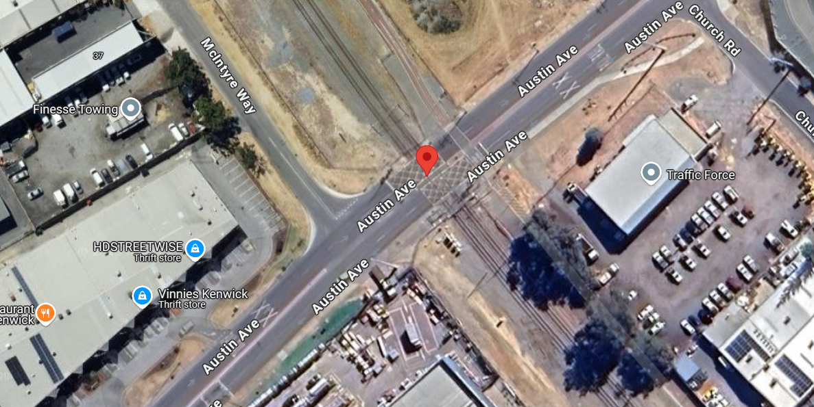
Notes:
32°02'43.4"S 115°58'36.9"E - Google Maps

Slide 111
N
W7-4
ID: 4251
Type: Public Road Crossing
Line/Branch Name: Main line
Crossing Kilometrage: 46.090km
Date: 07-APR-2025
Uptrack
RX-9
MAIN LINE To Helidon
To Ipswich
RX-5
RX-9

Slide 112
N
R1-2
15
W7-4
ID: 4251
Type: Public Road Crossing
Line/Branch Name: Main line
Crossing Kilometrage: 46.090km
Date: 07-APR-2025
RAILWAY PARADE
Building
SIDLES RD
18m
7.1m
36m
x
Uptrack
RX-9
MAIN LINE To Helidon
To Ipswich
RX-5
RX-9
7.2m
x
38m
7.5m
x
71m
18m
x
Carpark
x
x
DAISY BLAIR LANE
(gravel)
16m
W7-4
No sign

Slide 113
Crossing Characteristics
In order to give each level crossing a rating, in addition to the crossing control measures, various crossing characteristics at the crossing site are also recorded.
The following characteristics and controls are used to describe a road level crossing and its environment. Data must be collected as described in order to accurately rate each characteristic and control present at the crossing.
Staff involved in the rating of crossings must be familiar with road and rail Standards and legislation, or obtain information from appropriate stakeholders.

Slide 114
Effectiveness of Equipment Inspection
Options:
Good – An effective inspection and maintenance program is evident
Average - An inspection program exists but maintenance follow up is inadequate
Poor - No inspection and maintenance program exists
It is not generally possible on-site to determine an inspection frequency, although the condition of the signs and equipment may be used as a guide. If the signs are faded and show signs of unrepaired damage this may indicate that a maintenance program is not in place.
Short Stacking
Options:
Short stacking is not an issue or available space is greater than or equal to the longest vehicle +5m.
Short stacking could be an issue or available space is less than longest vehicle +5m but the vehicle is likely to be able to clear
Short stacking is an issue or available space is less than the length of the longest vehicle + 5m
Use the dimension measured to intersection/control point to determine if there is a possibility of short stacking
Notes:
Effectiveness of Equipment Inspection
The controls and/or infrastructure at a level crossing (e.g. warning signs, road marking or active control i.e. flashing lights and/or boom gates), must be regularly inspected in order to remain effective.
The regular inspection and maintenance of active controls is much more critical than for passive controls, as motorists may assume that if the active signal is not operating there is no train.
RIMs generally have regular, frequent inspections of active level crossings and are required to keep records of this inspection under their rail safety accreditation. The RIM will therefore be able to provide information regarding the frequency of inspection.
Short Stacking
Short stacking is a situation where the distance between the railway crossing and adjacent road intersection is insufficient for a single vehicle to stand and give way to other traffic without stopping on or blocking the level crossing.
Unless the road is designated specifically to exclude heavy vehicles, or where it would not be possible for such a vehicle to negotiate the crossing road surface, a standard semi-trailer with a nominal length of 19m should be used as the longest vehicle.
If the road is a designated RAV route then use the length of the largest legal vehicle for that route.

Slide 115
Vulnerability to Road User Fatigue
Options:
Non-fatigue zone - frequent curves and driver interactions
Possible fatigue zone – highway environment
Fatigue zone – identified fatigue zone
If the road environment is boring it is vulnerable to fatigue related accidents. Non-fatigue zones are those with many driver interactions on the approach.
Presence of Adjacent Distractions
Options:
Few or no distractions and warning signs/crossing stands out
Some distractions but warning signs/crossing generally stands out
Many distractions and warning signs/crossing does not stand out
If the driver is confronted with a large number or variety of visual distractions in the vicinity of the crossing, the advance warning or controls at the crossing may be overlooked or not recognised.
Notes:
Vulnerability to Road User Fatigue
Driver interactions include sharp curves, corners, traffic controls, etc., or where a driver’s awareness is increased due to other factors such as speed reduction, or negotiation of an intersection. A level crossing which is immediately adjacent to a turn off from a high-speed environment is considered a non-fatigue zone.
Possible fatigue zones include long stretches with few driver interactions.
Presence of Adjacent Distractions
Locations where few or no distractions occur are country areas or open streets with buildings located away from the roadside.
Locations with some distractions are those where there is some signage or buildings in the vicinity of the road, but these do not directly compete with the crossing control.
Locations with many distractions are busy suburban streets with footpaths close to the roadside and many advertising signs on or near the kerbside aimed at attracting the driver’s attention.

Slide 116
Condition of Traffic Controls at Crossing
Options:
Complete and in good order
Some wear and tear but the message is understandable
Deteriorated so that the message is unreadable or does not exist
If the crossing control is incomplete or in poor condition a driver may not recognise the crossing, or misinterpret the message of the traffic control.
Visibility of Traffic Control at Crossing
Options:
Easily observed from the calculated S1/SSD
Partly obscured, poorly aligned, but visible from the calculated S1/SSD
Not visible from the calculated S1/SSD or does not exist
If the crossing controls cannot be clearly seen and identified (due to obstructions or road alignment) from the calculated S1/SSD, there is a danger the road user will be unaware of the presence or location of the crossing, even though advance warning signs may exist.
Notes:
Condition of Traffic Controls at Crossing
Select the first option if signage or active control meets the current Standard, is complete, and in good order. It must also not be defaced, damaged or badly faded to the point where it affects the driver’s recognition of the control message.
Select the second option if signage or active controls are worn, but still understandable. They must generally be complete in terms of the current or superseded Standard but may be slightly damaged or faded in a way which does not significantly affect the driver’s recognition of the control message.
Select the third option if signage or active control is badly damaged, defaced or faded to the point where the driver may not recognise the control message, or traffic control does not exist.
Visibility of Traffic Control at Crossing
If flashing lights exist at the crossing, also consider the correct focusing of the lights. If the light assembly is visible at the correct distance, but the lights are misaligned so that the driver is not able to discern that they are operating, then they are not visible.
If the crossing control can be easily seen and identified from the calculated S1/SSD point, and the lamps (in the case of active controls) are correctly aligned, then choose the first option.
If the crossing control is visible but partly obscured by vegetation or structures so that it is not fully identifiable, or the lamps are poorly aligned, then choose the second option.
If the crossing control cannot be seen from the calculated S1/SSD point, or there is no control provided, then choose last option.

Slide 117
Distance From Advance Warning to Crossing
Options:
Advance warning is not required or the distance from the advance warning to the crossing is greater than or equal to the required distance
The distance from the advance warning to the crossing is less than the required distance but more than the safe stopping distance (S1/SSD)
Less than the safe stopping distance (S1/SSD) or advance warning does not exist
Advance warning signs, where required, must be present and correctly positioned to give drivers adequate warning of the presence of the crossing. There are some circumstances in low speed environments where advance warning is not required
Conformance with Standard AS1742.7/NZTA TCD Part 9
Options:
Controls (signs and road markings) conform to AS 1742.7/NZTA TCD Part 9
Controls (signs and road markings) do not conform to AS 1742.7/NZTA TCD Part 9 but are understandable
Controls (signs and road markings) do not conform to AS 1742.7/NZTA TCD Part 9 and are not understandable
AS 1742.7/NZTA TCD Part 9 specifies traffic control to be provided in terms of signage, line marking, advance warning and active control configurations. This includes the specification of signage configuration and the correct placement of such infrastructure. Consistent control provides drivers with clearly recognisable indications regarding level crossings
Notes:
Distance From Advance Warning to Crossing
If the advance warning signs are placed at their correct positions or at a greater distance than required, or no signage is required as specified by AS 1742.7/NZTA TCD Part 9, then choose the first option.
If the signage is placed at a lesser distance than required by AS 1742.7/NZTA TCD Part 9, but at greater than the safe stopping distance, then choose the second option.
If the signs are placed closer than the safe stopping distance, or are not present at all, then choose the last option.
Conformance with Standard AS1742.7/NZTA TCD Part 9
If all infrastructure complies with the AS 1742.7/NZTA TCD Part 9, choose the first option.
If infrastructure does not meet the letter of the Standard but performs the function of that infrastructure, then choose the second option. For example:
• all signs or markings are present, visible and unambiguous, are out of position to a minor degree but still provide sufficient warning,
• minor signage components are missing, obscured or reversed (warning signs facing outwards rather than inward) but the assembly is still clearly recognizable, or
• infrastructure is in accordance with a previous, commonly understood Standard.
If major components of the infrastructure are missing and/or the positioning of the infrastructure is in error so that sufficient warning is not given, choose the last option.

Slide 118
Likelihood of Vandalism Controls
Options:
Low — vandalism is unlikely – no history or evidence
Medium — no evidence of vandalism to crossing but is common in local area
High — vandalism is common or very likely
Vandalism of crossing controls may cause them to be not operational or not visible to road users
Level of Service (Vehicle Congestion)
Options:
Austroads level of service A — free flow
Austroads level of service B — stable flow, reasonable freedom to select speed
Austroads level of service C — stable flow, restricted freedom flow
Austroads level of service D – flow becoming unstable flow, all drivers restricted in freedom to select speed
Austroads level of service E – traffic volumes are close to capacity
Austroads level of service F — forced flow
The level of service (LOS) is a rating of the level of congestion of traffic flow at a level crossing during peak periods. Higher congestion levels may cause greater distraction, as drivers deal with negotiating heavier traffic and may not observe level crossing warnings.
Notes:
Likelihood of Vandalism Controls
Vandalism of crossing controls may cause them to be not operational or not visible to road users.
If there is no evidence or history of vandalism occurring, then choose the first (low) option.
If the crossing is in an area where vandalism is common, but the crossing itself has not been targeted then choose the second (medium) option.
If there is current evidence or record of frequent vandalism to the crossing, then choose the high option.
Level of Service (Vehicle Congestion)
For more information on LOS, refer to the “Austroads Guide to Traffic Management Part 3: Traffic Studies and Analysis”.
Also, refer to Appendix D of Crossing Assessment Handbook.

Slide 119
Queuing From Adjacent Intersections
Options:
No queues back to the crossing
No known queuing however traffic environment could allow queuing
Traffic known to queue back to the crossing
If traffic is held up due to queuing at an intersection or other permanent or regular obstruction just past the crossing, then it is possible that vehicles will be unable to clear the track and foul an approaching train.
Seasonal/Infrequent Train Patterns
Options:
Regular train patterns
Infrequent/irregular/seasonal train patterns
Regular and predictable train movements are less risky than infrequent or irregular train movements, because local road users will become used to the pattern of train movements and be more aware of their presence
Notes:
Queuing From Adjacent Intersections
If there is no apparent cause for queuing in the road alignment, such as neighbouring intersections, and no history of queuing incidents, then choose the first option.
If the road alignment and features indicate that queuing may potentially occur (even though there is no particular history of such behaviour), then choose the second option.
If there is a significant history of queuing occurring at the site, then choose the last option
Seasonal/Infrequent Train Patterns
Seasonal train patterns, e.g. when no trains run for much of the year and then appear during the agricultural season, are particularly risky as road users may assume that the crossing is unused and ignore the controls.
If trains run daily on a regular pattern or timetable, then choose the first option.
If trains run seasonally or only every few days, then choose the last option.

Slide 120
Road Surface on Approach (Not Crossing Panel)
Options:
Sealed/good condition
Sealed but breaking up/unsealed but firm
Unsealed/loose
If the road surface is poor, the braking and acceleration abilities of the motor vehicle may be compromised
Is The Crossing on a Hump, Dip or Rough Surface
Options:
No hump, dip or rough surface (crossing is level)
Hump, dip or rough surface exists (i.e. a low clearance vehicle could be stranded)
If the grade on the road approaches rises steeply on either side of the crossing so that the track is on a mound, or there are significant dips or deep potholes in the road close to the crossing, there may be the potential for long low vehicles to become grounded on the tracks as they cross. Such a stuck vehicle will be unable to move off the crossing as a train approaches.
Notes:
Road Surface on Approach (Not Crossing Panel)
If the road is sealed and in good condition, choose the first option.
If the road surface is unsealed but well maintained and without excessive loose surface material, or sealed but showing signs of wear or cracking, choose the second option.
If the surface is unsealed and loose, or if the road is potholed (whether sealed or not), choose the third option.
Is The Crossing on a Hump, Dip or Rough Surface
Note: A Hump is not a crest
A hump may occur on a rising or falling grade. The significant aspect of a hump is that the track is considerably higher than a straight line between the points on the road where the vehicles wheels will run. Low loaders are particularly vulnerable to becoming stranded.
Evidence of scraping on or in the vicinity of the crossing panel may indicate the potential for vehicles to become stuck. The road authority and/or RIM may also have knowledge of vehicles becoming stuck on the crossing.

Slide 121
Possible Sun Glare Sighting Crossing on Road Approach
Options:
Sun glare is not a problem on the road approach
Sun glare may be a problem on the road approach
If the road user approaching the crossing is unable to see the controls at the crossing due to the sun being directly behind the controls, then there is an increased risk of a collision
Possible Sun Glare Sighting Train
Options:
Sun glare is not a problem on the rail approach
Sun glare may be a problem on the rail approach
If the road user, stopped at a crossing which is not actively controlled, looks along the track and cannot see the approaching train due to sun glare behind the train, there is an increased risk of collision.
Notes:
Possible Sun Glare Sighting Crossing on Road Approach
Note: When surveying, Sun Glare should only be recorded as “Observed”, and is dependent on the time of day and prevailing weather conditions. LXM supposedly calculates where Sun Glare is a problem for either control and or train.
As the sun travels through a range of directions at sunrise and sunset depending on the time of year and the latitude of the crossing location, judgment as to whether sun glare may be a problem is not simply a matter of whether the road runs east-west.
Local knowledge at the site may also be useful in determining whether a sun glare risk exists.
Possible Sun Glare Sighting Train
The LXM database sighting calculation considers these factors to flag whether sun glare may be an issue.
Considerations similar to road approach sun glare should be used to determine if there is an actual risk of sun glare.

Slide 122
Temporary Visual Impediments – Sighting of Crossing Controls
Options:
No known visual impediments which may impact on the visibility of crossing controls
Visual impediments which may impact on the visibility of crossing controls (1 day/yr.)
Visual impediments which may impact on the visibility of crossing controls (1 day/mth)
Visual impediments which may impact on the visibility of crossing controls (1 day/week)
If the crossing location regularly suffers from environmental conditions such as dust, fog, or mirage so that visibility of the crossing controls is reduced as the road user approaches, then the risk of collision is increased
Temporary Visual Impediments – Sighting of Train
Options:
No known visual impediments which may impact on the visibility of an oncoming train
Visual impediments which may impact on the visibility of an oncoming train (1 day/yr.)
Visual impediments which may impact on the visibility of an oncoming train (1 day/mth)
Visual impediments which may impact on the visibility of an oncoming train (1 day/week)
If a road user stopped at a passively controlled crossing is unable to see an approaching train due to visual impediments, then there is a risk of collision.
Notes:
Temporary Visual Impediments – Sighting of Crossing Controls
Such a risk can only be determined by reliable local knowledge.
Observing the phenomenon while on-site may indicate the severity of the problem, but frequency may be hard to judge.
Meteorological information may be available to indicate if fog may be an issue.
Choose the option which describes the likelihood and frequency of the visual impediment.
Temporary Visual Impediments – Sighting of Train
The same issues of determining the frequency and incidence of the hazard apply as for visual impediments on the road approach.
Choose the option which describes the likelihood and frequency of the visual impediment.

Slide 123
Observations
Any non-compliances to AS 1742.7/NZTA TCD Part 9 and other matters of interest that may be observed when inspecting/rating a crossing should be recorded as observations.

Slide 124
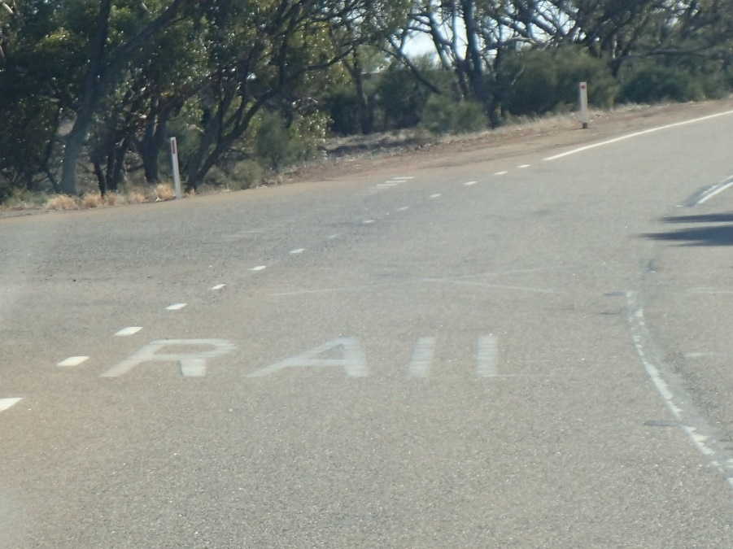
Site Observations
Observations may include:
Non-conformity to the Standard.
Damage to infrastructure.
Road/path condition issues.
Line marking issues.
Vegetation causing sighting limitations.
Problematic driver behaviour.
Vehicles parked on private property that could interfere with sight lines.
Other unexpected issues observed on site.
↓ Vehicle parked on private property obscuring sight lines
↑ Faded pavement markings

Slide 125
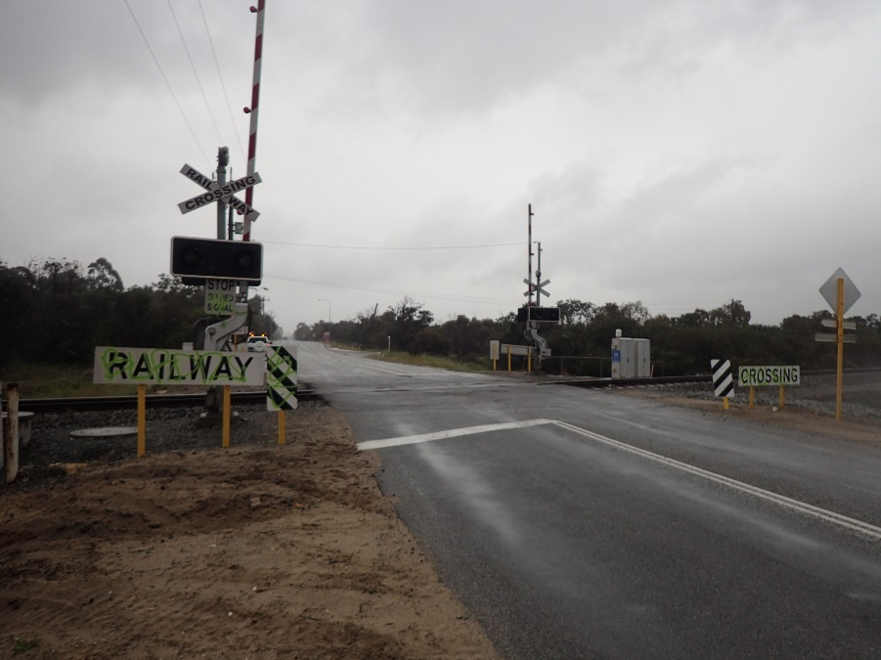
Example Observation Photographs
↓ Partially obscured S1 sighting & faded advanced warning signage
↑ Non-conformity to standard – incomplete RX-2 assembly
↑ Vandalism to crossing controls & incorrectly positioned hold lines

Slide 126
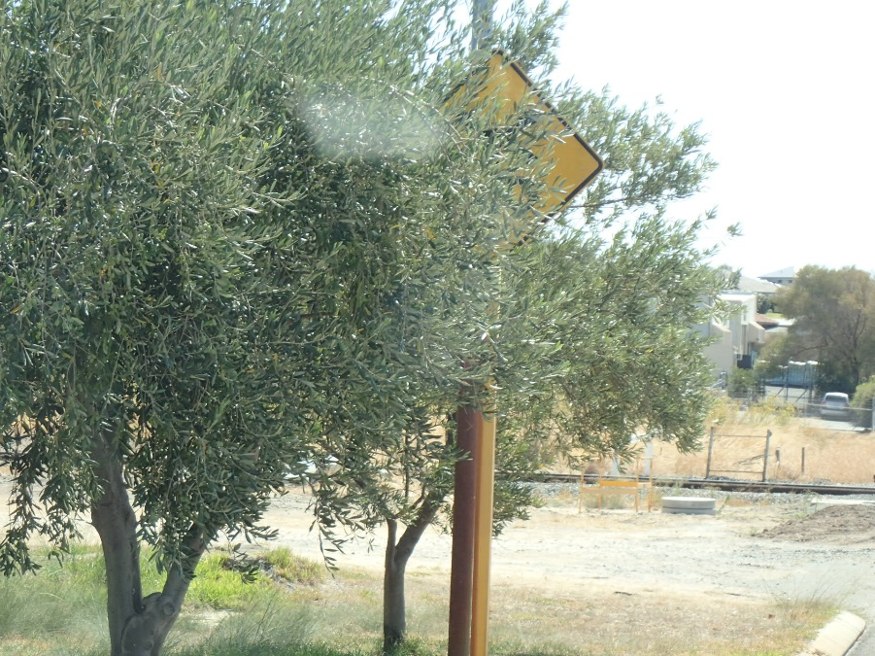
Example Observation Photographs
↓ Poor road surface
↑ Poor road surface
↑ Advanced warning obscured by vegetation

Slide 127
Questions

Slide 128
Matt Garratt
Module 3a Pedestrian Crossing Field Survey
07-APR-2025
Notes:
NOTE: The intention of this Module is to demonstrate how an ALCAM assessment of a pedestrian crossing facility is completed.
This Module is intended to be taken in conjunction with Module 3 – Level Crossing Field Assessment.
It is also assumed that the individuals utilising this Module are familiar with the requirements of AS1742.7 in respect to pedestrian crossing facilities.

Slide 129
Site Definition

Slide 130
Orientation of the site
ALCAM surveys and the LXM software use a consistent convention to refer to the orientation of level crossing sites.
Up direction is towards the origin of the track. i.e. when standing at the crossing and facing in a direction of decreasing track kilometrage, you are facing in an Up direction.
Down direction is away from the origin of the track. i.e. when standing at the crossing and facing in a direction of increasing track kilometrage, you are facing in a Down direction.
Note: The interpretation of Up direction may vary between jurisdictions and should be confirmed.
Locations of level crossings are referred to by their running kilometrage, or the distance (in kilometres) from the origin of the line.
The direction of the road or path approaches is defined as left or right, based on the observer’s left- or right-hand side when at the crossing facing in the Up direction.
Notes:
Other factors to be considered include crossing loops, sidings, balloon loops and fork lines.
Crossing (or passing) loops and sidings will usually follow the Up Direction of the main line from which they originate.
Balloon loops and fork lines (for turning trains or other train manoeuvres) also usually follow the Up Direction of the main line from which they originate, in increasing meterage, to the end of the balloon loop where it re-joins itself. In some jurisdictions, the Up Direction at balloon loops may depend on the direction of train operations around the balloon. The Rail Infrastructure Manager (RIM) can advise the Up Direction for a line.
Note: Orientation of site should resemble whatever is portrayed on the site sketch

Slide 131
Pedestrian facilities
A level crossing site may comprise of:
A single pedestrian crossing
A road crossing with one or more adjacent pedestrian crossings, or
Multiple pedestrian crossings with no adjacent road crossing e.g. at station platforms
In the case of a site with multiple pedestrian facilities, each is identified by a unique identifier.
Notes:
The pedestrian facility located in the Up direction is identified as crossing #1 with the Down direction crossing identified as crossing #2

Slide 132
Pedestrian facilities
Similarly, where a multi-track crossing also has multiple pedestrian facilities, each is identified by a unique identifier.
Notes:
Ped Crossing # 1 – Up Right
Ped Crossing # 2 – Up Left
Ped Crossing # 3 – Down Right
Ped Crossing # 4 – Down Left

Slide 133
Office Based Data Collection
There are a number of pieces of information which are required to be collected prior to travelling to site to undertake an ALCAM assessment.
This information includes the level crossing location details, rail traffic information and pedestrian traffic information.

Slide 134
Crossing Location Details
The following crossing location details are to be collected prior to travelling to site to undertake an ALCAM assessment;
LXM/ALCAM Crossing ID
Crossing Class
Road Name (where applicable)
Line Section & kilometrage
Suburb
Surrounds
Rail Infrastructure Manager
Path Manager

Slide 135
Rail Traffic Information
The following rail traffic information details should be obtained from the relevant Rail Infrastructure Managers prior to travelling to site to undertake an ALCAM assessment;
Physical tracks
Operational tracks
Train Speeds
Maximum
Minimum
Permanent Speed Restrictions
Train Volumes (Yearly, Weekly or Daily)
Longest Train Length
Average Wagons
Average Occupancy
Active Warning Timings
Longest
Shortest

Slide 136
Pedestrian Traffic Information
The following pedestrian traffic information details should be obtained from the relevant Path Managers prior to travelling to site to undertake an ALCAM assessment;
Daily pedestrian volumes
Peak hourly pedestrian volumes
Pedestrian types & proportions
Children
Physically disabled
Sensory disabled
Intellectually disabled
Cyclists, wheelchairs, prams, etc.
Elderly

Slide 137
Site Sketch
A site sketch of the crossing must always be prepared as part of the site survey. The sketch does not need to be to scale but should be reasonably proportionate to illustrate the site, provided there is room to clearly add dimensions and other relevant information.
If suitable aerial photography or mapping is available this can be used as a basis for this sketch and may be prepared in the office prior to travelling to site. Where the site sketch is pre-prepared, it should be ensured that the sketch is verified on site and all required information is included on the sketch.
Where pedestrian crossings are located adjacent to a road level crossing, it is preferable to sketch each pedestrian crossing separately for clarity.

Slide 138
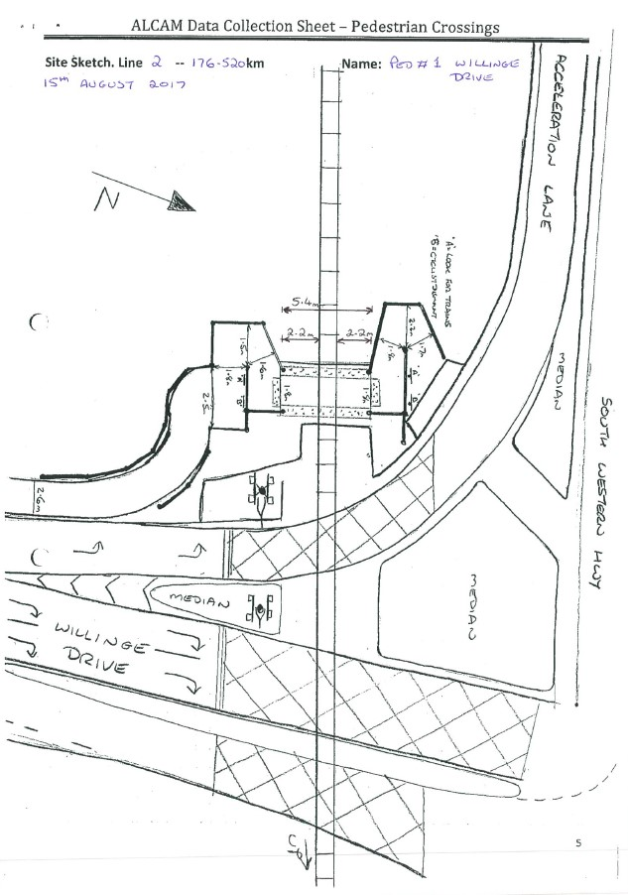
Site Sketch Information
The site sketch should be a clear and legible plan view of the crossing and include the following:
Crossing details – ID number, line/branch name and rail kilometrage.
Date of the site survey to which the sketch relates.
The Up direction & north point.
All road names.
The location and alignment of all railway tracks in the vicinity of the crossing.
The path approach alignment
All crossing signage
Any features in the vicinity of the crossing which effect approach visibility
Any other significant features which will be shown on site photographs.
Dimensions between outside rail and maze opening
Internal dimensions of mazes
Notes:
The site sketch should be orientated in such a way to ensure that the required information is presented in a clear & legible manner.
For sites with single approaches and as an ALCAM field survey is predominantly road based, the orientation of the site sketch recommended is with the sketch drawn in portrait mode, the left road approach from the bottom of the page with up track direction to the left of the page.

Slide 139
Site Assessment Methodology

Slide 140
Location 1 – Left Approach
Follow necessary Rail Infrastructure Manager processes for advising train control of ALCAM assessment being undertaken at crossing.
Measure approach path width
Measure the confines of the maze to determine the narrowest point within the maze

Slide 141
Location 2 – Right Approach
Measure approach path width
Measure the confines of the maze to determine the narrowest point within the maze

Slide 142
Location 3 – Crossing Panel
Measure the crossing path width between TGSIs or delineation lines
Measure the shortest distance from hold point to outer rail for the left approach
Measure the shortest distance from hold point to outer rail for the right approach
Measure the total crossing distance from hold point to hold point.
Notes:
Note: Not all hold points are at 90 degrees to the nearest rail

Slide 143
Location 4 – Left Approach
Measure the cross fall grade of the approach path
Measure the longitudinal grade of the crossing path at the hold point

Slide 144
Location 5 – Right Approach
Measure the cross fall grade of the approach path
Measure the longitudinal grade of the crossing path at the hold point

Slide 145
Location 6 – Left Approach Hold Point
Measure available sighting – UP Direction
Measure available sighting – DOWN Direction

Slide 146
Location 7 – Right Approach Hold Point
Measure available sighting – UP Direction
Measure available sighting – DOWN Direction

Slide 147
Location 8 – Left Approach Site Photographs
Take photograph showing general overview of crossing.
For actively controlled or crossings adjacent to active level crossing controls, take photograph of Location Case/Crossing ID
Take photograph of the alignment of the pedestrian facility of the approach
Take photographs of the signage affixed to the pedestrian facility
Take photograph of the available sighting – UP Direction
Take photograph of the crossing panel – Across Track (capture hold point in present)
Take photograph of the available sighting – DOWN Direction

Slide 148
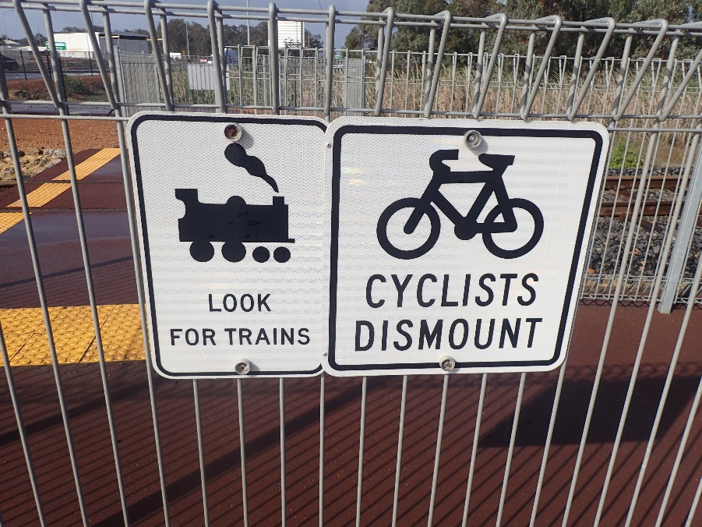
Example Photographs
↓ Maze Alignment Left Approach
↑ Crossing Overview
↑ Crossing Protection Left Approach

Slide 149
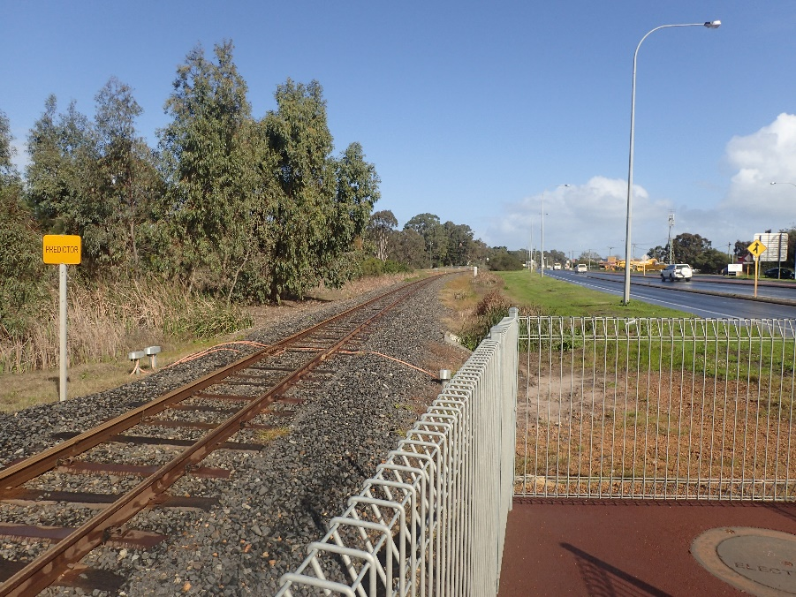
Example Photographs
↓ Crossing Panel Left Approach
↑ Sighting Left Up
↑ Sighting Left Down

Slide 150
Location 9 – Track Panel
Ensure that it is safe to enter the Danger Zone
Move to a position up track of the crossing where facing in a down direction a photograph of the entire crossing surface panel can be taken.
Move to a position down track of the crossing where facing in an up direction a photograph of the entire crossing surface panel can be taken.

Slide 151
Example Photographs
↓ Track Up
↓ Track Down

Slide 152
Location 10 – Right Approach
Take photograph of the available sighting – UP Direction
Take photograph of the crossing panel – Across Track (capture hold point in present)
Take photograph of the available sighting – DOWN Direction
Take photographs of the signage affixed to the pedestrian facility
Take photograph of the alignment of the pedestrian facility of the approach

Slide 153
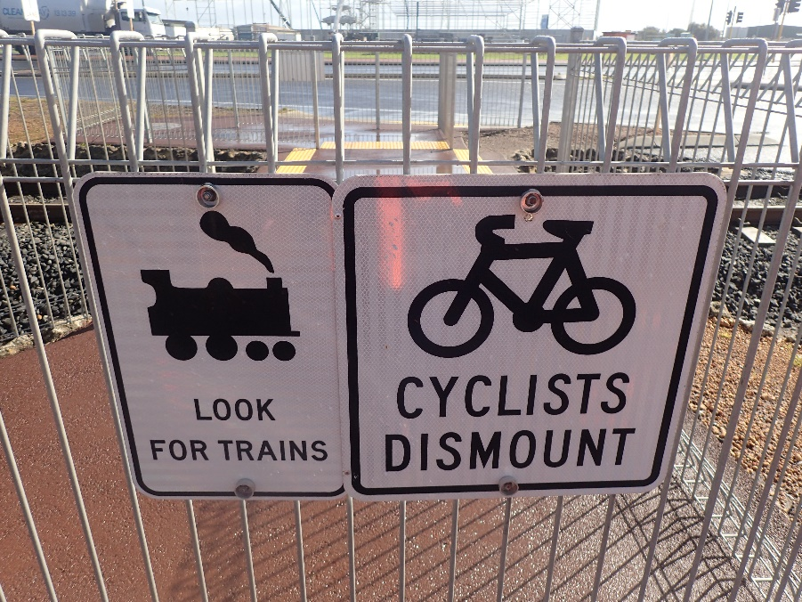
Example Photographs
↓ Maze Alignment Right Approach
↑ Crossing Number
↑ Crossing Protection Right Approach

Slide 154
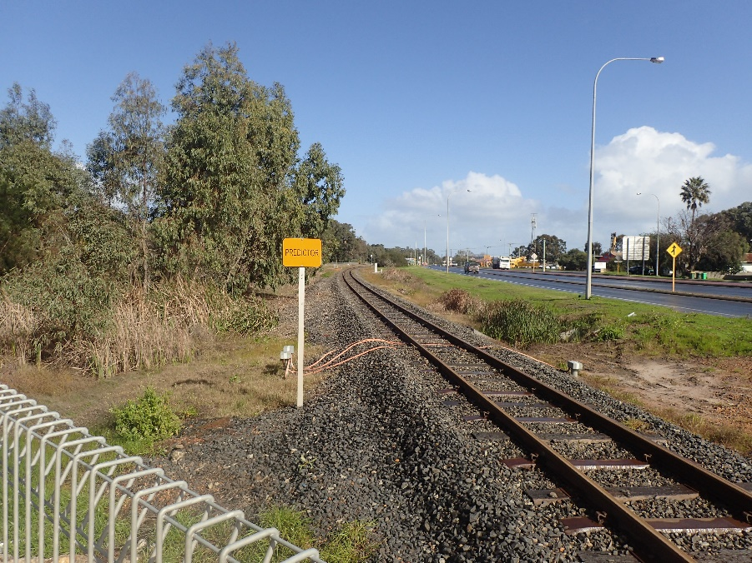
Example Photographs
↓ Crossing Panel Right Approach
↑ Sighting Right Up
↑ Sighting Right Down

Slide 155
Photo Naming Conventions
The use of a standard naming convention for photographs, which includes a standard naming of approach quadrants is recommended. This has the advantage that users of the data can tell by the name of the photograph from which direction and orientation it was taken.
Jurisdictions or organisations may have existing photo naming conventions in place, the table to the right is an example of a naming convention used by some jurisdictions/organisations.
Standard Name | Description
PX176.520km_ID | Crossing Name and Number
PX176.520km_Overview | General overview of crossing
PX176.520km_MAL | From the S1/SSD point on the left approach facing Up Direction
PX176.520km_MAR | From the S1/SSD point on the left approach facing to crossing
PX176.520km_PL | Crossing protection on left road approach
PX176.520km_PR | Crossing protection on right road approach
PX176.520km_S2LU | From the hold point on the left approach sighting Up Direction
PX176.520km_S2LA | From the hold point on the left approach facing across crossing
PX176.520km_S2LD | From the hold point on the left approach sighting Down Direction
PX176.520km_S2RU | From the hold point on the right approach sighting Up Direction
PX176.520km_S2RA | From the hold point on the right approach facing across crossing
PX176.520km_S2RD | From the hold point on the right approach sighting Down Direction
PX176.520km_TD | View across crossing in Down Direction
PX176.520km_TU | View across crossing in Up Direction
Notes:
An automated process of renaming photographs may be used. Use of such a system is most efficient where the standard photographs are taken in order on-site but renaming (and therefore reordering) can be achieved in the office after the event if necessary. For efficiency, the order of photographs taken should minimise the distance travelled on-site by the photographer.
The choice of whether to use a photograph naming convention and which one to use will be made by the jurisdiction and will balance field efficiency with the long-term usefulness of the data.
If a naming convention is not used, the assessor must show the photo number and direction on the site sketch.

Slide 156
Site Sketch

Slide 157
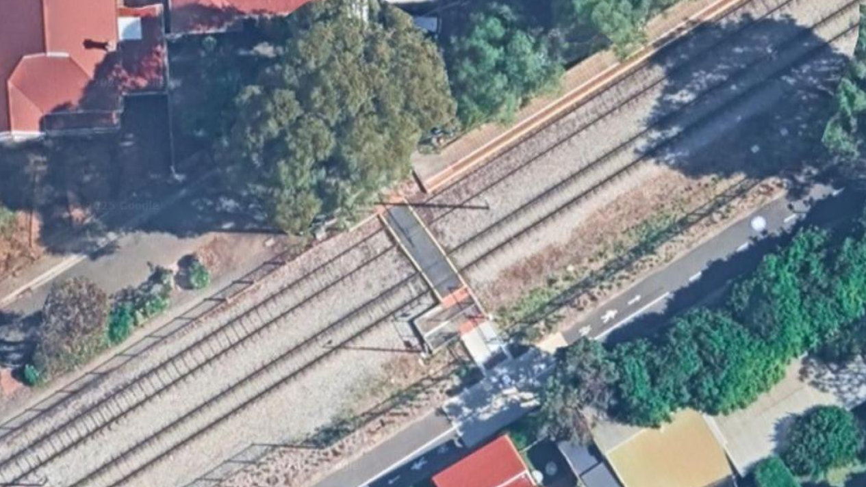

Slide 158
G9-58
Example from AS1742.7
W7-14-6 Attached to fence
Assy RX-12 Standing and flashing red signal with tone generator
Fence
TRACK
Fence
W7-14-6 Attached to fence
G9-58

Slide 159
G9-58
Site Sketch Checklist
☑
Infrastructure such as mazes or gates…
1.2%
W7-14-6 Attached to fence
☑
…noting the dimensions of paths and fencing should also be recorded for determining compliance to standards
1.7m
Assy RX-12 Standing and flashing red signal with tone generator
Fence
5.8%
1.5m
TRACK
4.9m
1.2m
Fence
1.8m
6.3%
W7-14-6 Attached to fence
1.7m
G9-58
Level

Slide 160
G9-58
G9-58
Site Sketch Checklist
1.2%
W7-14-6
☑
all crossing signage and road/path markings (including TGSIs)
1.7m
RX-12
RX-12
5.8%
1.5m
TRACK
4.9m
1.2m
1.8m
RX-12
6.3%
W7-14-6
1.7m
Level
G9-58
G9-58
Notes:
Tactile Ground Surface Indicators

Slide 161
SHED
STATION ROAD
BIKE LANE
G9-58
N
Site Sketch Checklist
1.2%
W7-14-6
☑
the line or branch name
☑
the Up Direction (towards track origin)
1.7m
RX-12
☑
5.8%
the North point
Uptrack
1.5m
☑
all road names
☑
TRACK
MAIN LINE To Helidon
4.9m
1.2m
any features in the vicinity of the crossing which effect approach visibility, e.g. tall vegetation, fencing, and buildings and any other significant features which will be shown on site photographs
To Ipswich
1.8m
RX-12
6.3%
x
x
W7-14-6
1.7m
x
Level
UNSEALED / GRASS
G9-58
MARY ST

Slide 162
SHED
ID: 850
Type: Public Pedestrian
Line/Branch Name: Main line
Crossing Kilometrage: 43.140km
Date: 07-APR-2025
STATION ROAD
BIKE LANE
G9-58
N
1.2%
W7-14-6
1.7m
RX-12
5.8%
Uptrack
1.5m
Site Sketch Checklist
MAIN LINE To Helidon
4.9m
1.2m
To Ipswich
☑
crossing details – ID and rail kilometrage
1.8m
RX-12
☑
type of crossing – i.e. public, private, pedestrian
6.3%
x
x
☑
date of the site survey to which the sketch relates
W7-14-6
1.7m
x
Level
UNSEALED / GRASS
G9-58
MARY ST

Slide 163
Crossing Control Measures
An essential part of an ALCAM assessment is to observe and record all crossing control measures installed at a crossing for both the left & right approaches. These crossing control measures include items such as the physical controls, audio/visual controls and adjacent controls.

Slide 164
Physical Controls
The physical crossing controls are the controls which are installed at the crossing location and include;
Automatic Gates
Pedestrian Booms
Manual Gates
Mazes
Path

Slide 165
Audio Visual Controls
Pedestrian crossings may be fitted with dedicated audio/visual controls specific to the pedestrian facility, these controls should not be confused with any audio/visual controls associated with an adjacent level crossing.
These pedestrian facility audio/visual controls include;
Visual Alarm Only
Audible Alarm Only
Visual and Audible Alarm
Signs Only

Slide 166
Adjacent Controls
Where a pedestrian crossing facility is located adjacent to an actively controlled level crossing, the crossing controls of the adjacent crossing are incorporated into the ALCAM assessment.
Active adjacent level crossing controls include;
Adjacent Boom Gates and Audio
Adjacent Visual and Audio
Adjacent Boom Gates and Lights
Adjacent Lights Only

Slide 167
Pedestrian Signage / Path Markings
There are a number of signage and pavement marking factors which are included in a pedestrian ALCAM assessment, these include;
Sign Advising Train Speed
Sign “Crossing Unsuitable for Mobility Devices”
Active Sign “Another Train Coming” Warning
Holding Line (Painted Only)
Delineation Line Marking (Painted Only)
Tactile Ground Surface Indicators
Advance Warning Signs for Mobility Devices/Cyclists

Slide 168
Crossing Environment
There are a number of crossing environment factors which are included in a pedestrian ALCAM assessment, these include;
Path Lighting at Crossing
Maintenance of Vegetation
Target Boards / LEDs
Whistle Boards
Wing/Funnel/Guide Fencing
Funnel Pathway
Adjacent Corridor Fencing

Slide 169
Other Control Measures
Other control measures which may be present at the crossing location and which need to be recorded include;
Human Factors
Police Enforcement, Public Education Strategies, Fault Reporting Number, Supervising Children, CCTV
Emergency Egress
With Latch (including holding enclosure), Without Latch, None
Other Controls
Hand Signallers, Controlled Crossing Swing Gates, Healthy State Monitoring
Pathway Works
Flange Gap Fillers

Slide 170
Crossing Characteristics
In order to give each level crossing a rating, in addition to the crossing control measures, various crossing characteristics at the crossing site are also recorded.
The following characteristics and controls are used to describe a pedestrian level crossing and its environment. Data must be collected as described in order to accurately rate each characteristic and control present at the crossing.
Staff involved in the rating of crossings must be familiar with road and rail Standards and legislation, or obtain information from appropriate stakeholders.

Slide 171
Effectiveness of Equipment Inspection
Options:
Good – An effective inspection and maintenance program is evident
Average - An inspection program exists but maintenance follow up is inadequate
Poor - No inspection and maintenance program exists
It is not generally possible on-site to determine an inspection frequency, although the condition of the signs and equipment may be used as a guide. If the signs are faded and show signs of unrepaired damage this may indicate that a maintenance program is not in place.
Presence of Adjacent Distractions
Options:
Few or no distractions (and warning signs/crossing stands out)
Some distractions (but warning signs/crossing generally stands out)
Many Distractions (and warning signs/crossing does not stands out)
Notes:
Effectiveness of Equipment Inspection
The controls and/or infrastructure at a pedestrian level crossing (e.g. warning signs, pavement markings/TGSIs or active control i.e. flashing lights and/or gates), must be regularly inspected in order to remain effective.
The regular inspection and maintenance of active controls is much more critical than for passive controls, as users may assume that if the active signal is not operating there is no train.
RIMs generally have regular, frequent inspections of crossings and are required to keep records of this inspection under their rail safety accreditation. The RIM will therefore be able to provide information regarding the frequency of inspection.
Presence of Adjacent Distractions
If the user is confronted with a large number or variety of visual distractions in the vicinity of the crossing, the controls at the crossing may be overlooked or not recognised.
Locations where few or no distractions occur are country areas or open streets with buildings located away from the path.
Locations with some distractions are those where there is some signage or buildings in the vicinity of the path, but these do not directly compete with the crossing control.
Locations with many distractions are busy suburban streets with footpaths close to the roadside and many advertising signs on or near the kerbside aimed at attracting the driver’s attention.
In the case of pedestrians, distractions may also include advertising, shops etc. on and around the footpath which may draw the attention away from the level crossing controls.

Slide 172
Proximity to Passenger Station
Options:
More than 500 metres
500 to 100 metres
Less than 100 metres
A pedestrian crossing near a station may be used by pedestrians hurrying to catch trains which is known to be hazardous as attention may be distracted.
Proximity to Siding/Shunting Yard
Options:
More than 500 metres
500 to 100 metres
Less than 100 metres
This characteristic relates to the likelihood that shunting activities involving irregular movements of trains may potentially distract or confuse the user.
Notes:
Proximity to Passenger Station
A pedestrian crossing near a station may be used by pedestrians hurrying to catch trains.
This is known to be hazardous as attention is focused on the train waiting at the station and may be distracted from the approach of another train coming from the opposite direction.
Proximity to Siding/Shunting Yard
This characteristic relates to the likelihood that shunting activities involving irregular movements of trains may potentially distract or confuse the user.
Trains may change their direction of travel without warning or may mask or block an approaching train from view
Where the crossing is positioned within the siding or shunting yard, choose “less than 100m”.

Slide 173
Proximity to Licenced/special event venue (e.g. pub, club, sports ground)
Options:
More than 500 metres
500 to 200 metres
200 to 100 metres
Less than 100 metres
Crossings in the vicinity of these venues pose an increased risk due to the potential influence of alcohol or other distractions.
Proximity to school/playground and/or aged facilities
Options:
More than 500 metres
500 to 200 metres
200 to 100 metres
Less than 100 metres
Crossings in the vicinity of these facilities pose an increased risk due to the potential impaired physical or intellectual abilities of the users to negotiate the crossing safely
Notes:
Proximity to Licenced/special event venue (e.g. pub, club, sports ground)
If the crossing is in close proximity to licensed premises, then there is an increased risk of pedestrians using the crossing under the influence of alcohol or otherwise distracted.
Their ability to recognise and react appropriately to crossing control may be impaired.
Proximity to school/playground and/or aged facilities
If the crossing is near a school or playground, there is an increased risk of children using the crossing. They may have a reduced capacity to react appropriately to crossing controls.
If the crossing is near an aged care facility, there is an increased risk of elderly pedestrians using the crossing. They may have impaired physical and/or intellectual ability to negotiate the crossing safely.

Slide 174
Ambient noise level/audibility of alarm
Options:
Train and/or alarm is easily audible to pedestrians over background noise
Train and/or alarm is partially audible to pedestrians due to background noise
Train and/or alarm can not be heard over the background noise
Noisy environments which prevent pedestrians hearing these audible signals increase the risk at the crossing.
Adjacent road traffic activity
Options:
Quiet
Moderate
Busy
If the pedestrian level crossing is near roads, there an increased risk of pedestrians being distracted from noticing a train or pedestrian signal.
Notes:
Ambient noise level/audibility of alarm
Pedestrian crossing controls often rely on an audible alarm at the crossing or the sound of the approaching train and/or its horn to alert pedestrians to the presence of trains.
Noisy environments which prevent pedestrians hearing these audible signals increase the risk at the crossing.
Adjacent road traffic activity
If the pedestrian level crossing is near roads, there an increased risk of pedestrians being distracted from noticing a train or pedestrian signal.

Slide 175
Conspicuity of Pedestrian Control
Options:
Complete and in good condition
Some wear and tear, but the message is understandable
Deteriorated so that the message is unreadable (or does not exist)
If the crossing control (signage or flashing lights/gates) is incomplete or in poor condition a user may not recognise the crossing, or misinterpret the message of the control.
Visibility of Pedestrian Control
Options:
Easily observed from the approach
Partly obscured, poorly aligned but visible from the approach
Not visible from the approach (or does not exist)
If the crossing controls cannot be seen by pedestrians as they approach the crossing because they are obscured or incorrectly aligned (in the case of active control), or if the control is absent, then the pedestrian may not be aware of the presence of the crossing which poses an increased risk.
Notes:
Conspicuity of Pedestrian Control
Select the first option if signage or active control meets the current Standard, is complete, and in good order. It must also not be defaced, damaged or badly faded to the point where it affects the user’s recognition of the control message.
Select the second option if signage or active controls are worn, but still understandable. They must generally be complete in terms of the current or superseded Standard but may be slightly damaged or faded in a way which does not significantly affect the user’s recognition of the control message.
Select the third option if signage or active control is badly damaged, defaced or faded to the point where the user may not recognise the control message, or traffic control does not exist.
Visibility of Pedestrian Control
If the control can be observed from the path approaching the crossing, then choose the first option.
If the control is visible but partially obscured by vegetation or other features such as buildings, signs etc., or if the active control is incorrectly aligned so that the lights are only partly visible from the approach, then choose the second option.
If the control is not visible from the approach because it is completely obscured or does not exist, then choose the last option.

Slide 176
Likelihood of Vandalism Controls
Options:
Low — vandalism is unlikely – no history or evidence
Medium — no evidence of vandalism to crossing but is common in local area
High — vandalism is very likely or has been observed
Vandalism of crossing controls may cause them to be not operational or not visible to users
Notes:
Likelihood of Vandalism Controls
Vandalism of crossing controls may cause them to be not operational or not visible to users.
If there is no evidence or history of vandalism occurring, then choose the first (low) option.
If the crossing is in an area where vandalism is common, but the crossing itself has not been targeted then choose the second (medium) option.
If there is current evidence or record of frequent vandalism to the crossing, then choose the high option.

Slide 177
Type of pedestrians
There are multiple characteristics within the pedestrian model related to the types of pedestrians using a crossing, these pedestrian types are:
Children
Physically disabled
Sensory disabled
Intellectually disabled
Cyclists, wheelchairs, prams, etc.
Elderly
For each of the different types of pedestrian users there are three different options for selection when undertaking an ALCAM assessment, these options are:
Low proportion (<25%)
Medium proportion (25-45%)
High proportion (>45%)
Notes:
Types of pedestrians
School age children have a lesser capacity to understand and respond appropriately to pedestrian crossings. They may also be more likely to engage in inappropriate or dangerous behaviour in the vicinity of the crossing which may increase the risk.
Physically disabled pedestrians have a reduced capacity to negotiate pedestrian crossings due to a slower walking speed, and a reduced ability to negotiate imperfections in the surface of the path, which may result in tripping and falling.
Pedestrians with a disability affecting sight or hearing may be unable to use, or be unaware of, some of the controls at a crossing. A sight impaired person will have reduced or no awareness of signs or active visual controls, and a person with hearing impairment will have a reduced or no ability to hear approaching trains or audible alarms at the crossing.
Pedestrians who have an intellectual disability may have a reduced capacity to understand the dangers of pedestrian crossings and may therefore be at a greater risk.
Cyclists, wheelchair users, and people with prams may be at increased risk due to the difficulties of controlling a wheeled device. These may include the ability to stop when required, and issues with pavement variability and wide flange gaps catching the wheels.
Elderly users may be at increased risk due to the difficulties of crossing quickly, slipping or tripping on the tracks or not understanding the messages given by the infrastructure.

Slide 178
Seasonal/Infrequent Train Patterns
Options:
Regular train patterns
Infrequent/irregular/seasonal train patterns
Regular and predictable train movements are less risky than infrequent or irregular train movements, because users will become used to the pattern of train movements and be more aware of their presence
Angle of crossing and condition/width of flange gap
Options:
Crossing angle 70-90 degrees and flange gaps within limits
Crossing angle 30-70 degrees or flange gap outside limits but not excessive
Crossing angle less than 30 degrees or flange gap outside limits and excessive.
Wider flange gaps may cause wheeled devices such as prams and wheelchairs to become trapped in the gap. This issue is compounded by crossings which are not at right angles to the tracks.
Notes:
Seasonal/Infrequent Train Patterns
Seasonal train patterns, e.g. when no trains run for much of the year and then appear during the agricultural season, are particularly risky as users may assume that the crossing is unused and ignore the controls.
If trains run daily on a regular pattern or timetable, then choose the first option.
If trains run seasonally or only every few days, then choose the last option.
Angle of crossing and condition/width of flange gap
Ideally the path across a pedestrian crossing should be at right angles to the track, providing the shortest possible distance to traverse, reducing the possibility of confusion for sensory disabled people.
If the flange gap is wider than allowed, it may cause wheeled devices such as prams and wheelchairs to become trapped in the gap, posing an increased risk to the operator. This issue is compounded by crossings which are not at right angles to the tracks.
If the crossing is at or near (within 20 degrees) right angles to the track, the flangeway gap is less than 75mm maximum, and the depth is less than 50mm, choose the first option.
If the crossing is at a moderate skew, or the flangeway gap exceeds 75mm, or the depth is more than 50mm but is not considered excessive, choose the second option.
If the crossing is extremely skewed, or the flange gap is excessive and likely to pose a hazard to users of wheeled devices, choose the final option.

Slide 179
Condition of crossing (fencing/path surface etc.)
Options:
Maze fencing and/or adjacent fencing is in good condition, path in good condition
Maze fencing and/or adjacent fencing is in average condition, path in average condition
Maze fencing and/or adjacent fencing is in poor condition or missing, path in poor condition
Freight trains stand across crossing
Options:
Freight trains rarely stand across the crossing (exceptional circumstances)
Freight trains occasionally stand across crossing
Freight trains frequently stand across crossing
If trains are often left standing across crossings, pedestrians will be inconvenienced and unable to cross which may lead users to make unsafe decisions.
Notes:
Condition of crossing (fencing/path surface etc.)
If the condition of the maze and wing fencing is poor with holes allowing pedestrians through and/or the pathway surface on the crossing is in poor condition or is non-existent, pedestrians may choose to bypass the crossing infrastructure, placing them at greater risk.
The condition of the fencing and pathway should be assessed on site.
Freight trains stand across crossing
If trains are often left standing across crossings, pedestrians will be inconvenienced and unable to cross. This may lead pedestrians to make unsafe decisions to cross the crossing before the train arrives, or attempt to climb through the train.
Local knowledge and advice from RIMs may assist in determining how often trains stand across the crossing.
If the crossing traverses a rail yard or siding, there is likely to be a higher chance of standing trains.

Slide 180
Gradients, width and manoeuvring space of pathway/maze
Options:
Crossing fully meets DDA requirements (e.g. gradients, widths & manoeuvring space)
Crossing partially meets DDA requirements
Crossing does not meet DDA requirements
Refer to AS 1428 parts 1, 2, and 3 and AS 1742.7 for requirements concerning gradients, path widths and manoeuvring space through maze-ways and across the level crossing.
Change of path alignment between pedestrian maze and track panel
Options:
Adequate path alignment
Poor path alignment
The alignment of the footpath between a maze or enclosure opening, and the adjoining crossing panel pathway should ideally be an extension of the alignment of the path across the crossing.
Notes:
Gradients, width and manoeuvring space of pathway/maze
If pathways are of adequate width and provide an accessible surface as defined by the Standards, then choose the first option.
If the pathway does not strictly meet the letter of the Standards but is generally of reasonable condition and without severe gradients, then choose the second option.
If the crossing is clearly deficient with extremely narrow paths, awkward manoeuvring areas for wheelchairs and other mobility devices or incorporating excessive gradients, then choose the last option.
Change of path alignment between pedestrian maze and track panel
As specified in AS1428.1, footpaths across railway crossings shall provide a continuous accessible path of travel to connect adjoining public footpaths on each side of the crossing.
The placement of the tactile ground surface indicators (TGSI) and exit fencing leading from the maze should also align so that the pedestrian is directed from the maze onto the path crossing the tracks. This is particularly important for visually impaired pedestrians who may rely on consistent path alignment, correct placement of TGSIs and fencing to orient themselves at the crossing.
AS 1742.7 provides a diagram showing the correct alignment of fencing and TGSIs where the crossing is skewed.

Slide 181
Crossing to Australian standards (signage & path marking)
Options:
Crossing fully meets AS 1742.7/NZTA TCD Part 9 requirements
Crossing partially meets AS 1742.7/ NZTA TCD Part 9 requirements
Crossing does not meet AS 1742.7/ NZTA TCD Part 9 requirements
AS 1742.7/New Zealand Standard TCD Part 9 defines the requirements for accessibility of pedestrian crossings including gradients, widths, signage, fencing and other infrastructure and accessibility matters
Sun glare issue at crossing
Options:
Sun glare does not become a problem
Sun obscures approaching train
If pedestrians cannot see train because of sun glare at a passive crossing they may misjudge its approach.
Notes:
Crossing to Australian standards (signage & path marking)
AS 1742.7/New Zealand Standard TCD Part 9 defines the requirements for accessibility of pedestrian crossings by disabled people by defining required gradients, widths and manoeuvring space.
The Standards also define requirements for the consistency of signage, fencing and other infrastructure and accessibility matters.
It is important to note that this characteristic refers to the features in the immediate vicinity of the pedestrian level crossing. Issues which make accessibility to the crossing difficult on the approaches to the crossing do not pose an actual risk at the crossing are therefore not relevant to the risk assessment of the level crossing.
If the crossing meets the Standard, choose the first option.
If the crossing is generally in good condition and is readily accessible but does not meet the letter of the Standard, choose the second option.
If the crossing fails to meet the Standard in significant areas which affect the accessibility of disabled users of the crossing, choose the last option.

Slide 182
Temporary visual impediments
Options:
No known visual impediments which may impact on the visibility of approaching trains
Visual impediments regularly impact on the visibility of approaching trains
Regular heavy fog or smoke which impedes a pedestrian’s view of approaching trains can lead to misjudgement at passive crossings.
Masking of trains (moving or stationary) timetabling etc.
Options:
First train masks second train rarely or never (possibly effected by timetabling)
First train masks second train occasionally (possibly effected by timetabling)
First train masks second train frequently (possibly effected by timetabling)
Masking of trains occurs where one train obscures visibility of another.
Notes:
Masking of trains (moving or stationary) timetabling etc.
Masking of trains occurs where one train obscures visibility of another. This generally occurs where a train on one track is standing at or just departing from a station, preventing pedestrians from seeing another train approaching from the opposite direction on the other track. It can also occur where a siding or crossing loop is near the crossing, and waiting trains standing on the siding/loop obscure visibility of a train passing on the main line.
Whether or not masking occurs in practice will also depend on the timing of train movements.
The likelihood of masking occurring can therefore be determined by inspection of the track layout in the vicinity of the crossing, in conjunction with an understanding of the train timetables.
If the track layout means that masking cannot occur (such as where there is only one rail line, or trains very rarely stop), choose the first option.
If the track layout allows masking, but due to the normal timetabling of trains it rarely occurs, choose the second option.
If masking occurs on a regular basis on the site (such as where the crossing is adjacent to a passenger platform on dual/bidirectional lines where trains frequently stop) choose the last option.

Slide 183
Observations
Any non-compliances to AS 1742.7/NZTA TCD Part 9 and other matters of interest that may be observed when inspecting/rating a crossing should be recorded as observations.

Slide 184
Site Observations
↓ Non-conformance to standard – narrow mazes, narrow path, excessive flange gaps, TGSIs missing
Observations may include:
Non-conformity to the Standard.
Damage to infrastructure.
Crossing surface condition issues.
Approach path surface condition issues.
Vegetation causing sighting limitations.
↑ Damaged maze panels

Slide 185
Example Observation Photographs
↓ Poor approach path surface
↑ Non-conformity to standard – incorrect crossing width, no TGSIs installed
↑ Vandalism to crossing controls

Slide 186
Example Observation Photographs
↓ Poor crossing surface, large flange gaps
↑ Non-conformance to standard – incorrectly positioned TGSIs
↑ Lack of approach path maintenance

Slide 187
Assessment

Slide 188
Work Health & Safety Share
What are the risks with doing an ALCAM survey?
How will these risks be controlled?
Notes:
Risks that must be considered:
Traffic (road and rail)
Distraction (from devices and other)
Slips, Trips and falls
Dehydration
Sunburn
Unfavourable weather
End with plan for next day including what to bring.

